Slide 1
Human-In-The-Loop
Generative AI Lab Training Session
Dia Trambitas, Head of Product, John Snow Labs

Slide 2
Generative AI Lab Training Overview
Human‑in‑the‑Loop Workflow – Concept, workflow stages, tools, best practices and analytics.
Resources and Tools – Hub of Models, Prompts, Rules, Clusters,
De‑identification – Purpose, project setup, masking strategies and safe data export.
10-minute Break
PDF Annotation – with text-based models or with PDF specific models
LLM Evaluation & Comparison – Comparison project types, LLM integration, prompt import.
Audit Dashboard – Outlines the purpose of the audit trail, what is recorded and how to use the dashboard to ensure compliance.
API Integration – How to interact with Generative AI Lab from your data processing workflows

Slide 3
DEMO - resources
https://genailab.demo.johnsnowlabs.dev/
User/pass → shared via email (also check the spam folder)
Generative AI Lab Instance will be available for 2 weeks
Projects available for import here.
Download zip archive and remove .txt extension from filename
Import into Generative AI Lab
For running Prompts and LLM Evaluation& Comparison projects use your personal API keys. Make sure you remove them after testing.
Documentation available here.

Slide 4
Why is Data Annotation Crucial for NLP?
Transforming unstructured data into structured format.
Providing "ground truth" for model training and validation.
Enhancing the performance of NLP models.
Ensuring models understand context, sentiment, entities, etc.
A way of transferring annotators knowledge and experience to models.
The resulting models can only be as good as the training data.
Notes:
Transforming Unstructured Data: Turning, unstructured data into organized, structured formats for better analysis.
For instance, we have the ability to turn pdfs or handwritten documents into text that can then be corrected an annotated.
Providing "Ground Truth": Creating reliable, annotated datasets that serve as the foundation for model training and validation.
Enhancing NLP Performance: Boosting the accuracy and effectiveness of Natural Language Processing models through quality annotations.
Understanding Context & Sentiment: Ensuring models grasp nuances like context, sentiment, and entities for more human-like comprehension.
Transferring Knowledge: Leveraging annotators' expertise and insights to enrich model training and improve decision-making.
Quality of Training Data Matters: Remember, the performance of resulting models hinges on the quality of the training data used!

Slide 5
Role of Annotation Tools
Facilitate systematic and organized annotation.
Allow for collaborative annotation projects.
Ensure standardization and consistency.
Offer quality control and review functionalities.
Provide automation and AI-assisted features.
Notes:
Systematic Annotation: Streamline the annotation process for a more organized and efficient workflow.
Collaborative Projects: Enable teams to work together on annotation tasks, enhancing productivity and shared insights.
Standardization & Consistency: Maintain uniformity across annotations to ensure reliability and quality in the data.
Quality Control & Review: Implement robust review features to monitor and enhance the accuracy of annotations.
Automation & AI Assistance: Leverage automation and AI tools to speed up the annotation process and reduce manual effort.

Slide 6
Key Requirements for Annotation Tools
High productivity – keep annotators "in the zone"
  Intuitive, easy to learn
  Keyboard shortcuts
  How many clicks? How many eye movements?
  Automatic transition between documents
Teamwork
  Support for projects, teams, and role-based permissions
  Customizable workflows: validation, review, model training, etc.
  Collaboration: compare versions, share guidelines
  Versioning & audit trails
Improve over time
  New features and constant improvements
  Learn from annotators actions
  High-accuracy, configurable deep learning backend
  "Closed-loop" automation: pre-train, annotate, retrain, measure
Notes:
We built this tool because.......
High Productivity: Design tools that keep annotators focused and efficient, enhancing overall workflow.
User-Friendly Interface: Ensure the platform is intuitive and easy to learn, minimizing the learning curve.
Keyboard Shortcuts: Implement shortcuts to speed up tasks, reducing the number of clicks and eye movements required.
Seamless Document Navigation: Facilitate automatic transitions between documents for a smoother annotation experience.
Team Collaboration: Support projects with role-based permissions to enhance teamwork and streamline processes.
Customizable Workflows: Allow tailored workflows for validation, review, and model training to fit specific project needs.
Versioning & Audit Trails: Maintain clear records of changes and decisions for accountability and easy tracking.
Continuous Improvement: Introduce new features regularly, fostering an environment of ongoing enhancements.
Learning from Actions: Adapt and refine the system based on annotator interactions to improve efficiency.
High-Accuracy Backend: Utilize a configurable deep learning backend to boost annotation accuracy.
Closed-Loop Automation: Implement a cycle of pre-training, annotating, retraining, and measuring for
continuous model enhancement.

Slide 7
Let’s get started!
Notes:
With All of that context, It's time to start thinking about a use case, a project and how you want the flow to go.

Slide 8
The Hub Of Resources
Integration with Models Hub
  Check benchmarking information
  Download any resource with one click
Models
  Private repository of models
  Trained with Gen AI Lab, Manually uploaded, Downloaded from Models Hub
Rules
  Private repository of rules
  Rules editing interface
Prompts
  Private repository of prompts
  Prompt editing interface
Notes:
Our No-code annotation product aims to support every step in the development of your projects. To that end, we have access to resources for each part of the pipeline, your models, rules, and prompts, which we will go through individually and define in greater details. All three of these together will act in your pre-annotation server.

Slide 9
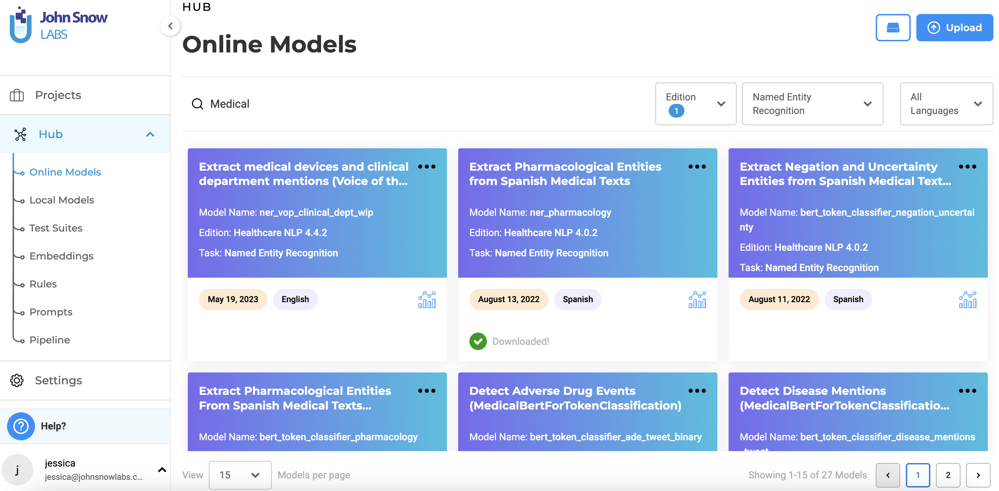
Choosing a Model
Notes:
Before you even start your project, it's a good idea to know what you want to do. In this case, since we'll be annotating a named entity recognition project, we'll want to find a model that has at least some of the entities that we'll be looking to annotate, so that we have less work to do. so we can go ahead and navigate to the model hub on the left side menu. Here, at the online model hub, you can see models that are free to use, or models that you have available for download by your license. You have the option to filter, show benchmark data and select the best model for your use case>
To touch briefly on Licensing, if you download Generative AI Lab from the AWS or azure marketplace,a payg license will be automatically generated, and if you download from on-prem, a license can be purchased.

Slide 10
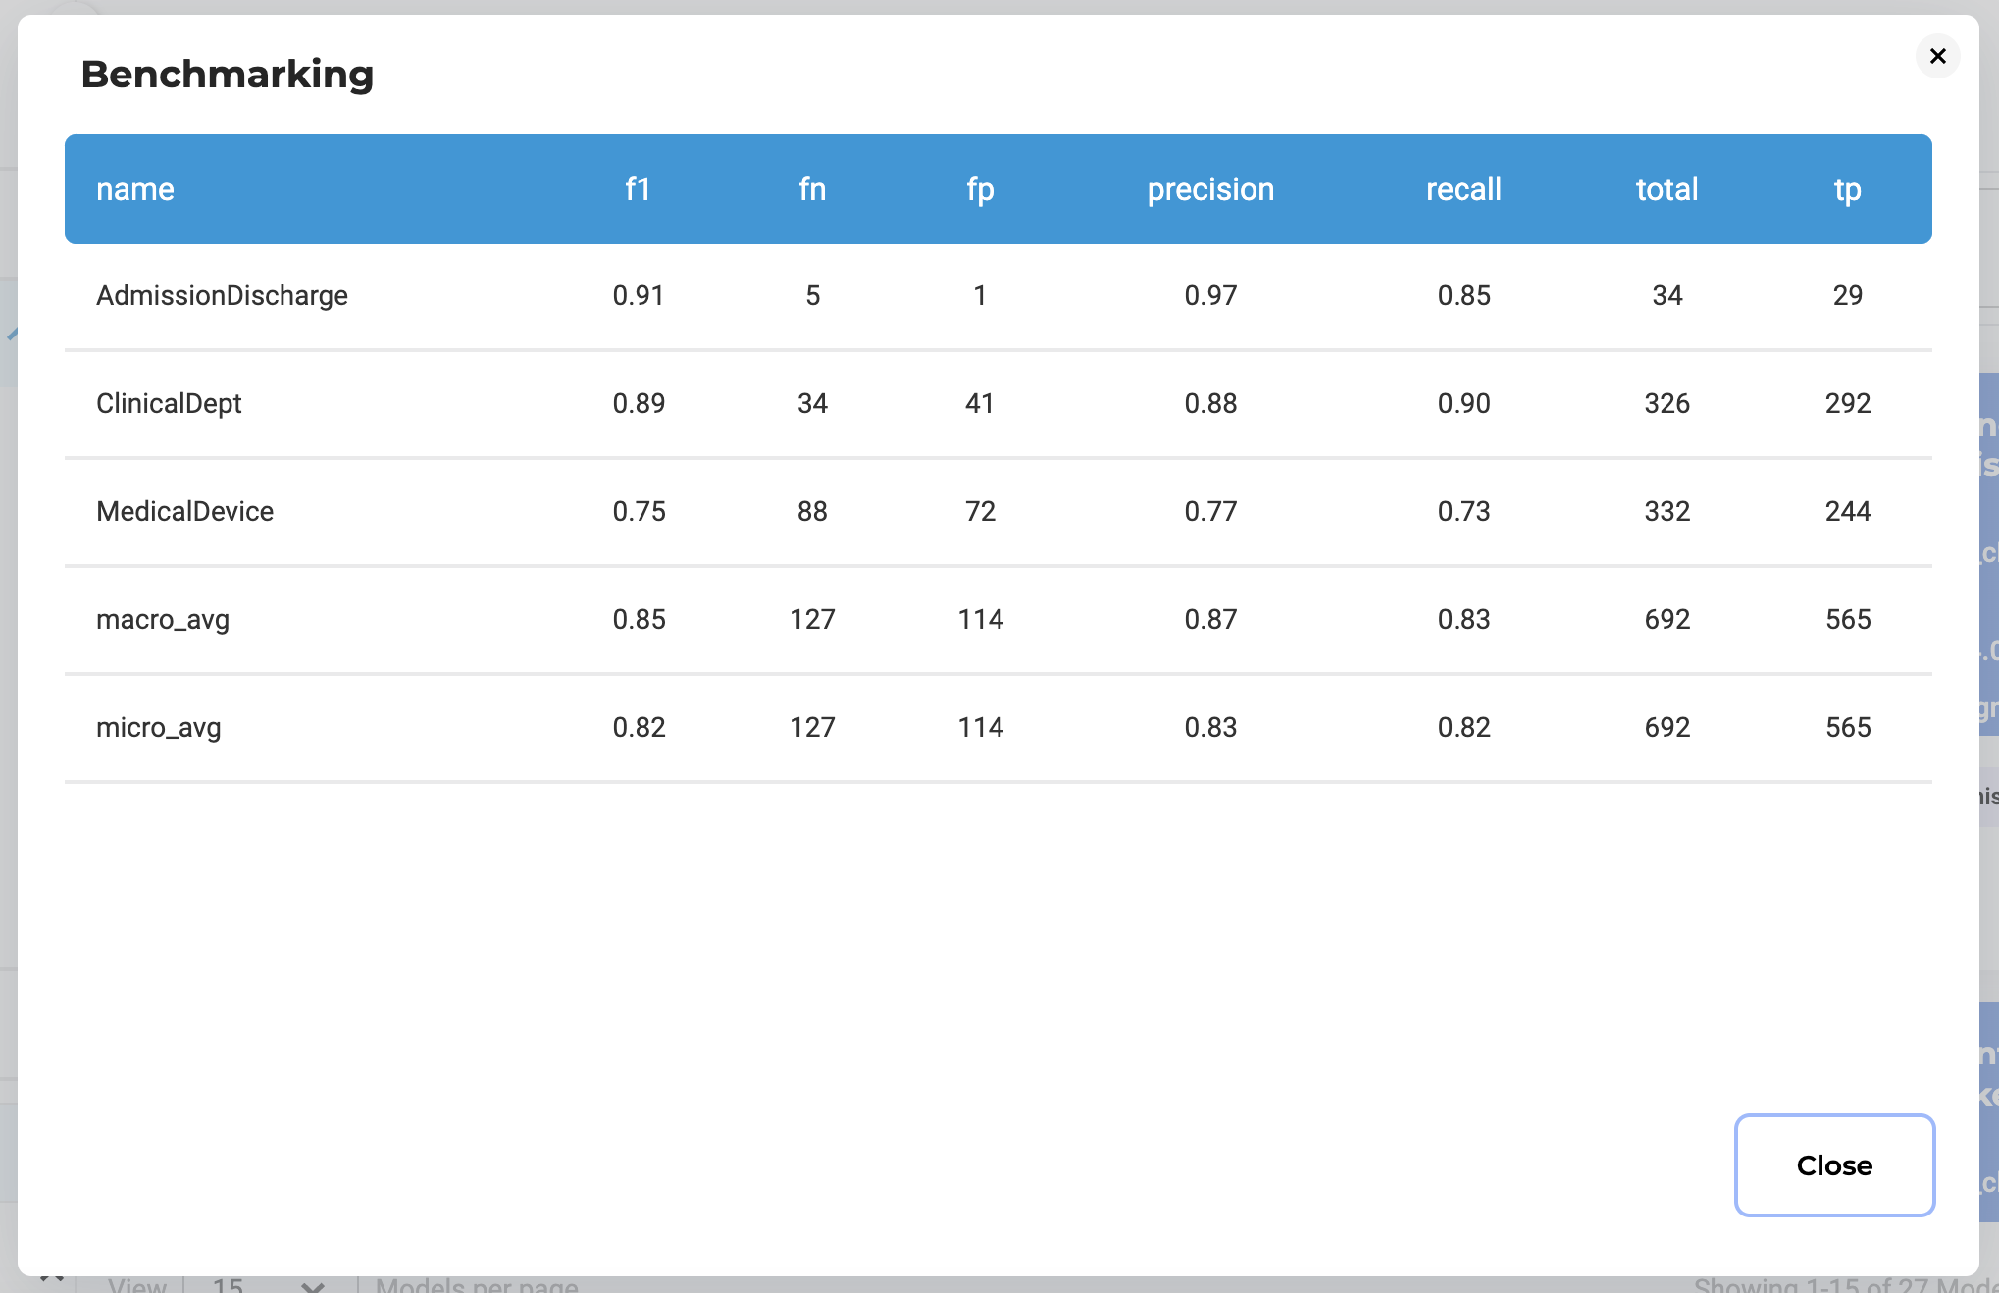
Reading Model Benchmarks
Notes:
Of course, with so many options to choose from, you're going to want to compare models. This can be done with the benchmarking tool in the bottom right of each model. If benchmarking is available, you'll have the ability to see the tests for each model. Only medical labels have this.
To briefly go over what each of these scores means,
F1 Score
The F1 score is the harmonic mean of precision and recall, providing a single metric to evaluate a model's performance on imbalanced datasets. It ranges from 0 to 1, with 1 being perfect precision and recall.
It is particularly useful when you need a balance between false positives and false negatives.
False Negative (FN)
A false negative occurs when a model incorrectly predicts a negative class for an instance that is actually positive. In NLP, this might mean failing to identify a relevant document or misclassifying a positive sentiment as negative. FN impacts recall negatively, as it represents missed opportunities for correct identification.
False Positive (FP)
A false positive occurs when a model incorrectly predicts a positive class for an instance that is actually negative. In NLP, this can mean falsely labeling irrelevant content as relevant. FPs negatively affect precision, indicating that the model is generating incorrect positive predictions.
Precision
Precision measures the accuracy of positive predictions made by the model. It is defined as:
where TP is true positives. High precision indicates that most predicted positives are indeed true positives, making it crucial in applications where false positives are costly.
Recall
Recall measures the model's ability to identify all relevant instances. It is defined as:
Recall=TPTP+FN\text{Recall} = \frac{TP}{TP + FN} Recall=TP+FNTP
High recall means the model captures most of the true positive cases, essential in scenarios where missing positives is detrimental.
Total
In this context, "total" often refers to the total number of instances in a dataset, which can include true positives, false positives, true negatives, and false negatives. It provides a complete view of the dataset size for calculating various metrics.
True Positive (TP)
A true positive is when the model correctly predicts a positive class for an instance that is indeed positive. In NLP, this means accurately identifying relevant documents or correctly classifying sentiment. TPs are crucial for calculating both precision and recall, reflecting the model's effectiveness in recognizing true positives.

Slide 11
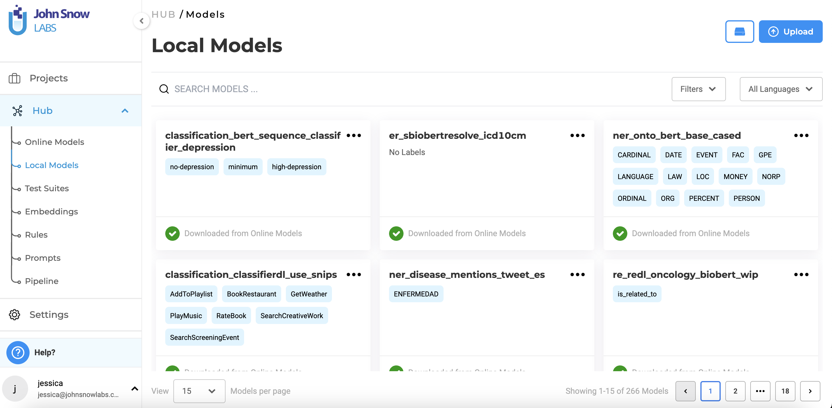
Your Private Models Hub
Notes:
Once you've chosen your models, you can view the ones that are downloaded and available without further licensing in the local models hub. This is also where models you've imported live. We currently support models that are built on Spark NLP.
Your uploaded models will only be made available to you team. They will NOT be put on the online model hub page.
You are able to see the amount of storage you have available for models with the little box button available just beside the upload page.

Slide 12
Rules - Introduction
Rules in NER
Definition: Predefined conditions/patterns for entity identification.
Implementation: Regular expressions or logical conditions.
Function: Alternative that compliments NER model outputs when NER model entities are not available
Example: Rule requires “Dr. Smith” to be followed by “MD” to validate entity.
Notes:
A rule in NLP and NER is a predefined condition or pattern used to identify and classify entities. It can be implemented as regular expressions or logical conditions. When applied alongside an NER model, rules serve as an alternative layer that refines the model's output.
After the NER model makes predictions, rules evaluate these results based on additional criteria. For example, a rule might specify that “Dr. Smith” should be followed by “MD” to be recognized as a valid entity. If the context is missing, the rule can filter out incorrect predictions.
This approach enhances precision by incorporating domain-specific knowledge and resolving ambiguities, ensuring more accurate entity recognition while leveraging the scalability of NER models.

Slide 13
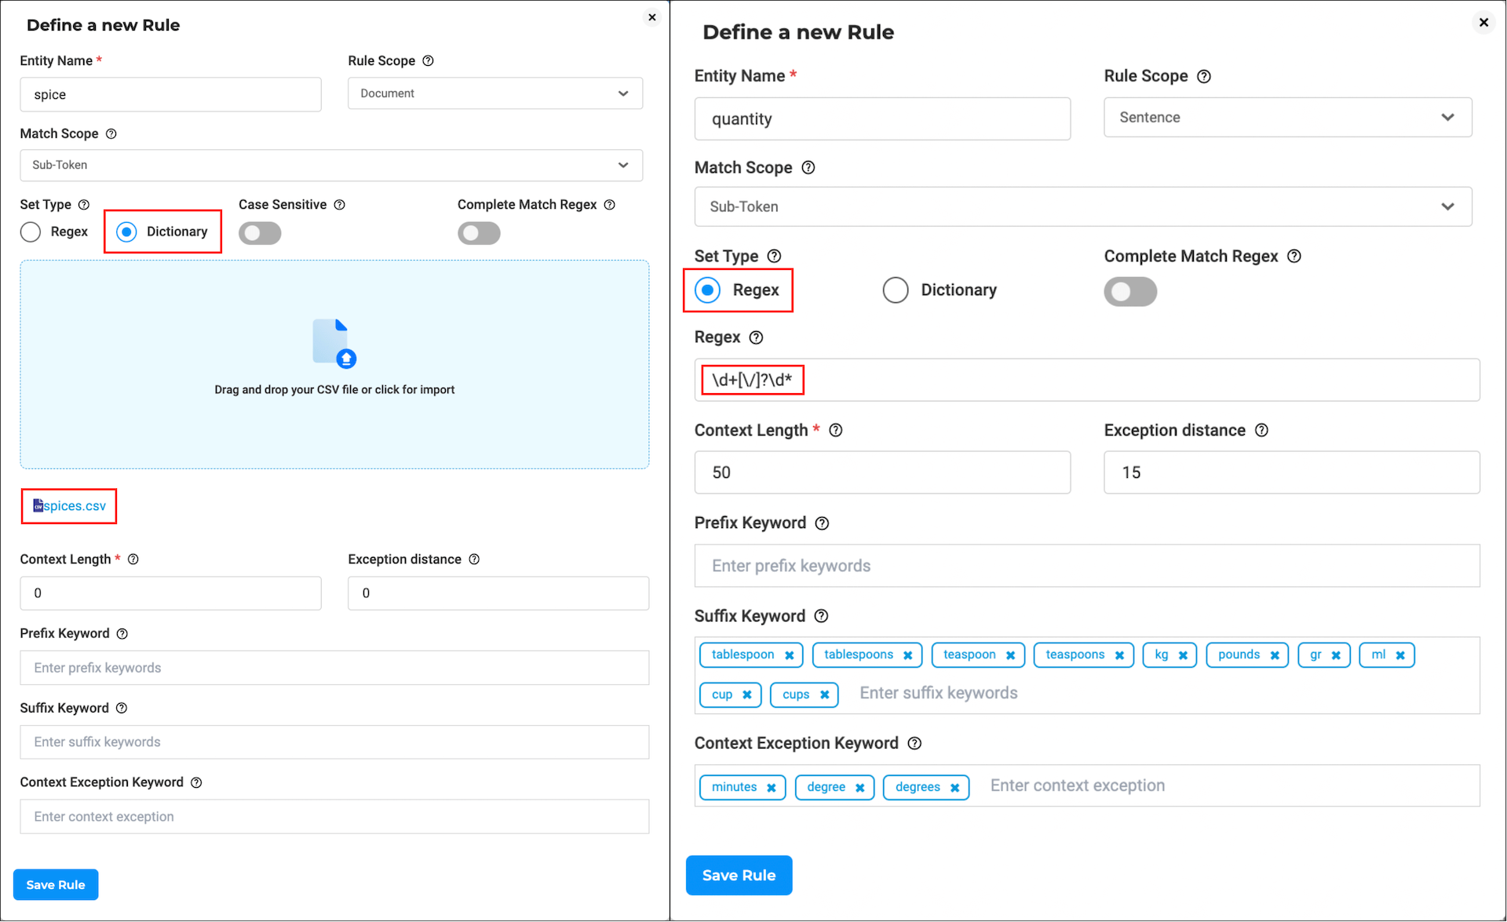
Rules - Regex
Users can define a regex (regular expression) that will be used to label all possible hit chunks and label them as the target entity.
For example, for labeling height entity the following regex can be used [0-7]'((0?[0-9])|(1(0|1)))''.
All hits found in the task’s text content that match the regex are pre-annotated as height.

Slide 14
Rules - Dictionary
Users can create and upload a CSV dictionary of keywords that cover the list of chunks that should be annotated as a target entity.
For example, for the label female, all occurrences of strings woman, lady, and girl within the text content of a given task will be pre-annotated as female.
Notes:
Before you even start your project, it's a good idea to know what you want to do. In this case, we want to.... so we can go ahead and navigate to the model hub on the left side menu. Here, at the online model hub, you can see models that are free to use, or models that you have available for download by your license. You have the option to filter, show benchmark data and

Slide 15
Prompts - Introduction
A zero-shot prompt is an instruction given to a model that asks it to perform a task without prior examples or specific training. The model generates a response based solely on its understanding of the prompt and general knowledge, rather than on learned patterns from labeled data.
Key Characteristics:
No Prior Examples: The model isn’t provided with demonstrations of the task.
Generalization: It relies on the model’s ability to generalize from its training data.
Flexibility: Zero-shot prompts allow models to tackle various tasks without retraining for each case.
Example Use Cases:
Text Classification: Asking a model to label a text as "positive" or "negative" without any labeled examples.
Notes:
A zero-shot prompt is a type of instruction given to a model (like a language model) that asks it to perform a task without any prior examples or specific training on that task. In other words, the model is required to generate a response or perform an action based solely on its understanding of the prompt and its general knowledge, rather than on learned patterns from labeled data.
Key Characteristics:
No Prior Examples: The model is not provided with examples or demonstrations of the task at hand.
Generalization: It relies on the model's ability to generalize from its training data to understand and respond to the prompt.
Flexibility: Zero-shot prompts enable models to handle a wide range of tasks without needing retraining or fine-tuning for each specific case.
Example Use Cases:
Text Classification: Asking a model to categorize a text as "positive" or "negative" based on sentiment without showing it any labeled examples.
NER
Classification

Slide 16
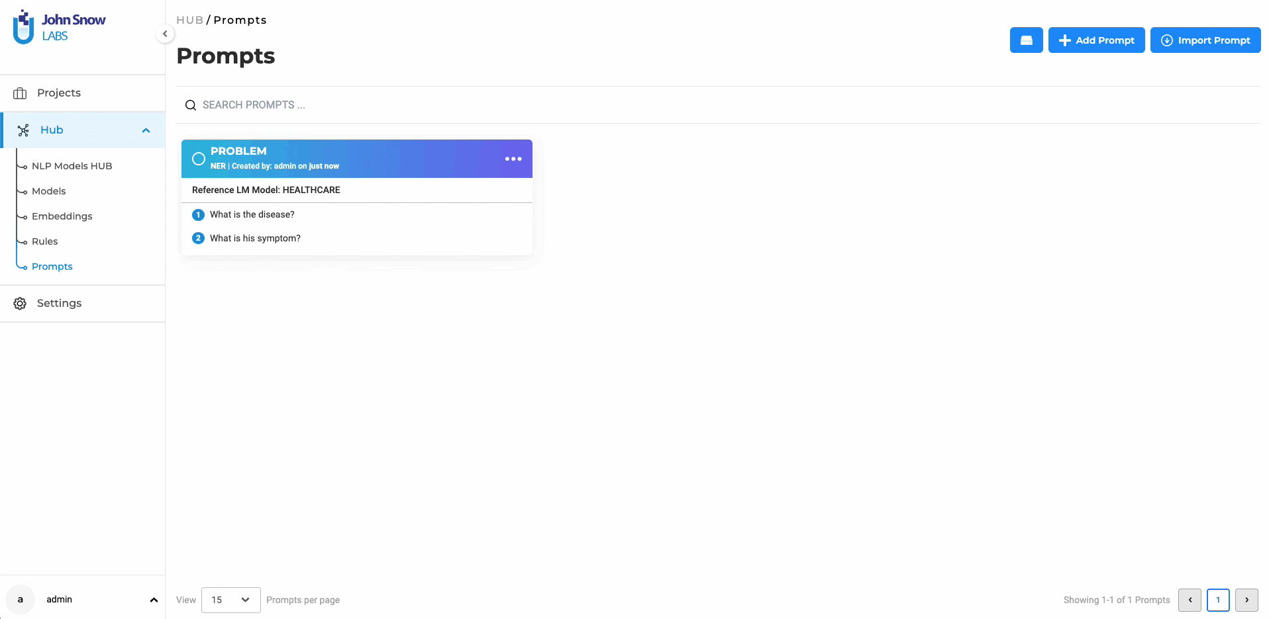
Creating Zero-Shot Prompts

Slide 17
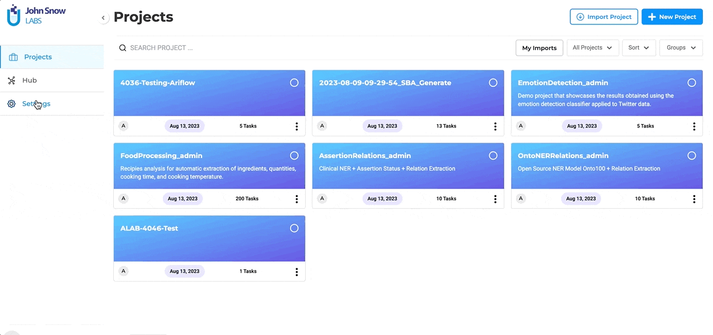
Creating LLM Prompts

Slide 18
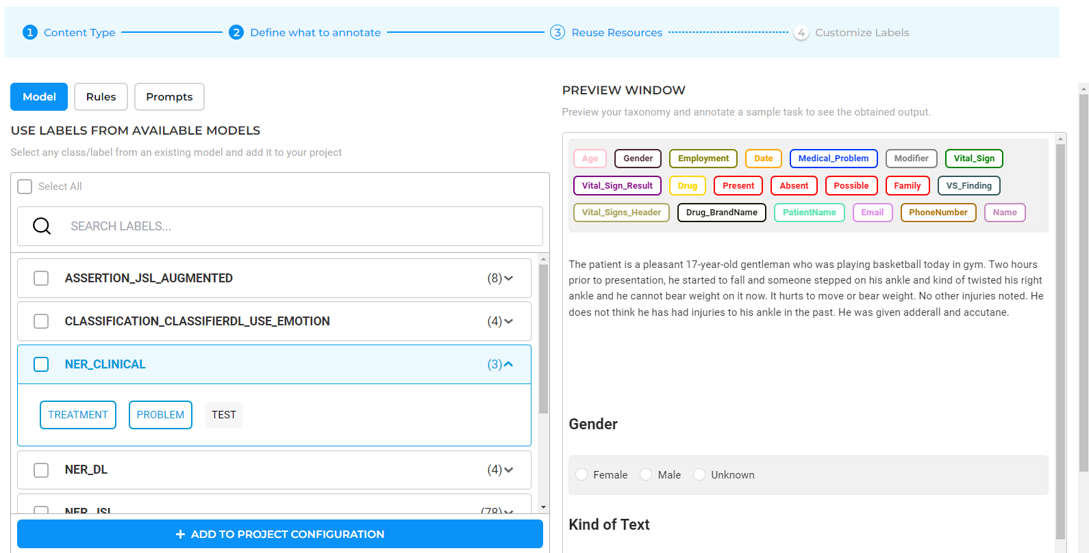
Reuse Resources in your projects
Notes:
Once you've chosen your models, created your rules, and defined your prompts, they are all saved separately so that you can continue to use them again and again in your projects. You wont need to define them for every new project.

Slide 19
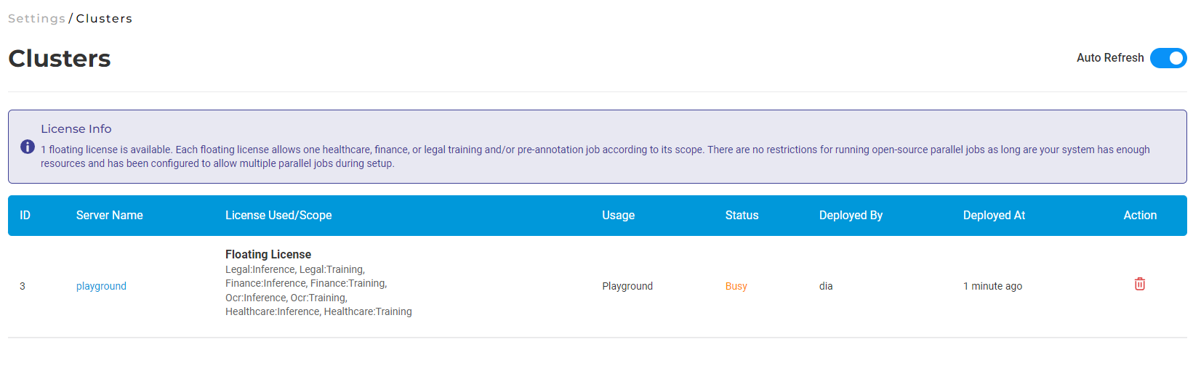
Clusters
Up-to-date information on the deployed servers
Computation resource management
Access deployed playground
Notes:
Generative AI Lab gives users the ability to view the list of all active servers. Any user can access the Clusters page by navigating to Settings > Clusters. This page provides the following details.
A summary of the status/limitations of the current infrastructure to run Spark NLP for Healthcare training jobs and/or pre-annotation servers.
Ability to delete a server and free up resources when required, so that another training job and/or pre-annotation server can be started.
Shows details of the server
Server Name: The name of server that can help identify it while running pre-annotation or importing files.
License Used/Scope: The license that is being used in the server and its scope.
Usage: Let the user know the usage of the server. A server can be used for pre-annotation, training, or OCR.
Status: Status of training and pre-annotation servers.
Deployed By: The user who deployed the server. This information might be useful for contacting the user who deployed a server before deleting it.
Deployed At: Shows when the server was deployed.

Slide 20
Project Setup
Project creation steps for Classification project
  Configuration, choices, hotkeys
Project creation steps for NER project
  Configuration, choices, hotkeys
Task import
Task assignment
Workflow details

Slide 21

Project Creation/NER
Login into Generative AI Lab
Once logged in,
in the projects page, select "New Project"
In the Project Description page, choose a name for your project and click Next. The name must be unique, you will get a warning in case there is already a project with the name you choose.
In the Add team Members page, use the "Search team Members" box to lookup usernames you want added to the project
Note: the users must be created and added to the system prior to assigning them to a project
Click Next. This takes you to the Configuration page. Configuring your project is a guided experience and has 4 steps displayed in the top horizontal bar:
Select Text Classification and click Next.
In Step 2 and 3 leave the default settings and click Next.

Slide 22
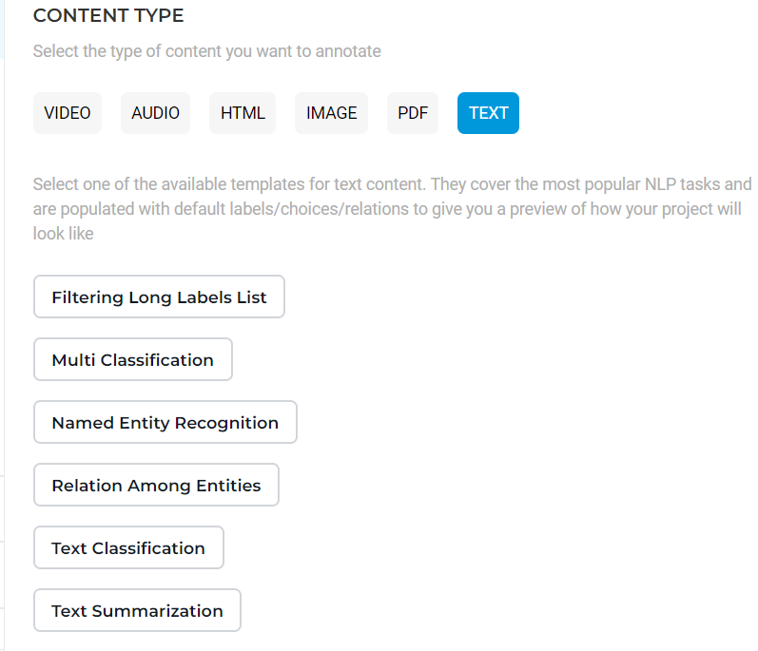
Project Creation/NER
Let’s create 2 different project types :
Text Classification and Named Entity Recognition
Select Named Entity Recognition and click Next.
In Step 2 and 3 leave the default settings and click Next.

Slide 23
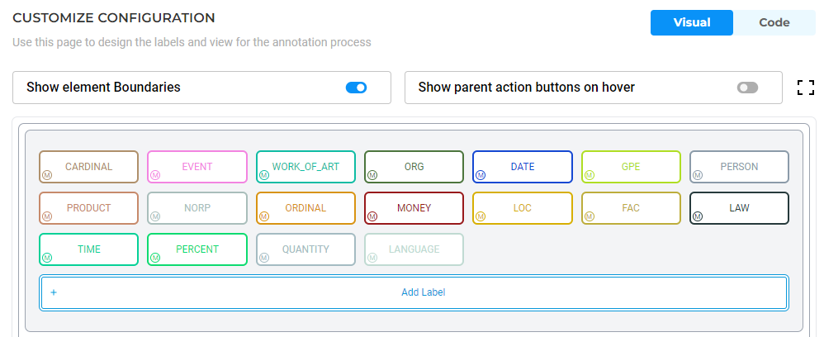
Project Creation/NER-cont
In Step 4 "Customize Labels“, by default, few labels are already populated for you.
Add yours then remove existing ones then click the Save Config button.
This takes us to the Import page where tasks will be imported into the project.

Slide 24
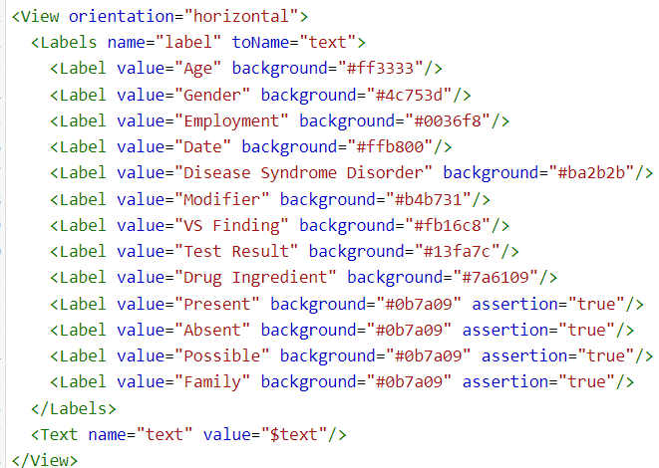
Project Creation/NER-cont
Tip: Remove unwanted labels by editing the xml config file. You can do this by switching modes between Visual to Code

Slide 25
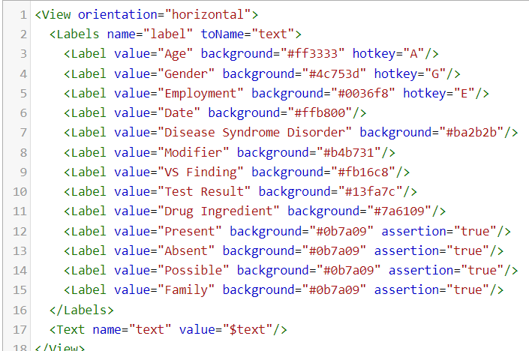
Project Creation/NER-cont
Creating hot keys.
Hot keys are keyboard shortcuts you can set for increasing productivity in the labeling process.
To setup hot keys, switch to Code mode and add hotkey tag:

Slide 26
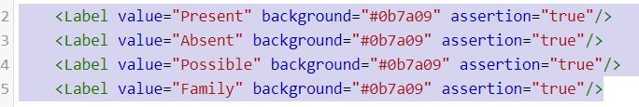
Project Creation/NER-cont
Assertion Labels
Assertion labels are tags with contextual information that are assigned to NER extractions. The typical example of assertion status detection is negation identification: in the sentence “the patient has no history of diabetes”, the word “diabetes” is annotated using both an NER label (Disease) and an assertion label (Absent).
These labels are defined using the configuration file as a “regular” label + assertion=“true”
Using the Annotation Lab, you can annotate assertion in a very simple way. First, choose a NER label and select the part of the text that you want to extract, and then choose an assertion label and select that same part of the document.
Read more about assertion labels here - https://www.johnsnowlabs.com/tips-and-tricks-on-how-to-annotate-assertion-in-clinical-texts/

Slide 27
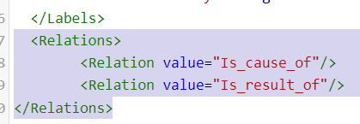
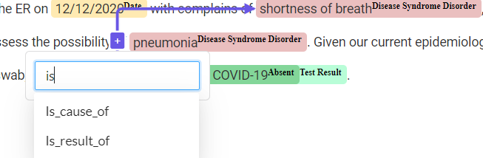
Project Creation/NER-cont
Creating relations
Relations can be defined using the configuration file by adding a Relation section as depicted in the screenshot below.
When creating the relation, the name defined in the configuration file is displayed in the UI.

Slide 28
Task Import and Assignment
When project setup is done, you will land on the Task page. The page is empty, and to import your tasks, click on the Import button – top right.

Slide 29
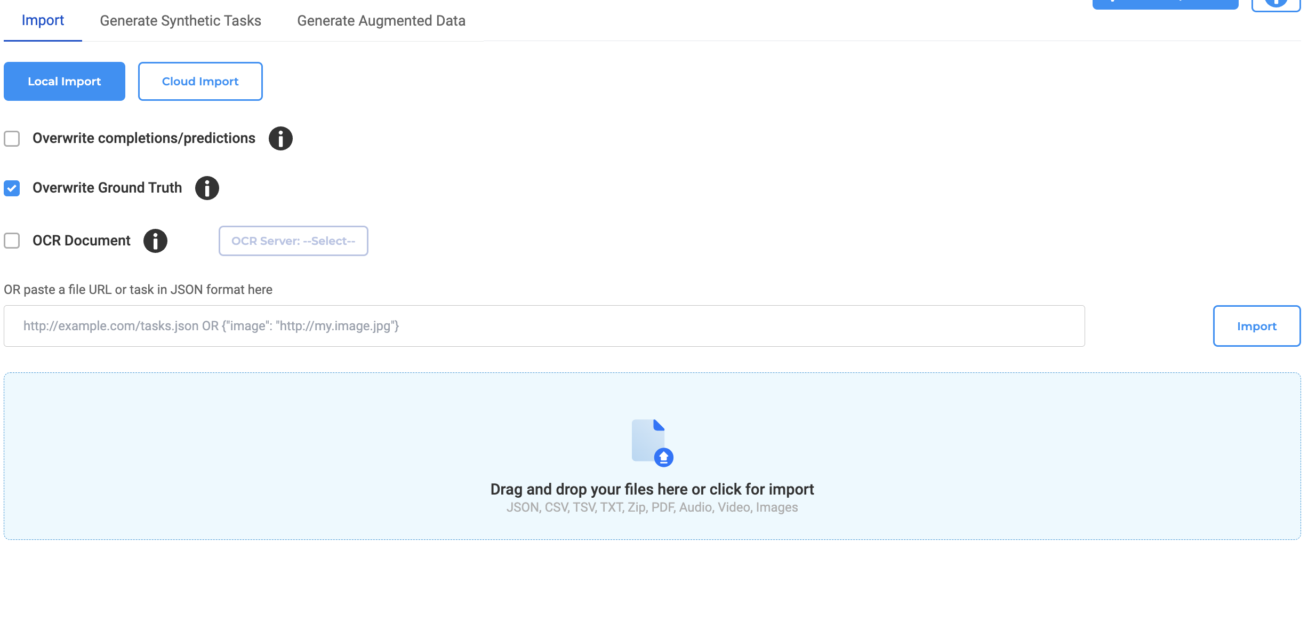
Task Import and Assignment
There are multiple ways for importing tasks,: using a zip archive with your text files, importing tasks using a csv file, using json file, etc

Slide 30
Exercise: Project Creation/Classification
Login into Generative AI Lab ​
Once logged in,
in the projects page, select "New Project"
In the Project Description page, choose a name for your project and click Next. The name must be unique, you will get a warning in case there is already a project with the name you choose.
In the Add team Members page, use the "Search team Members" box to lookup usernames you want added to the project
Note: the users must be created and added to the system prior to assigning them to a project
Click Next. This takes you to the Configuration page. Configuring your project is a guided experience and has 4 steps displayed in the top horizontal bar:
Select Text Classification and click Next.

Slide 31
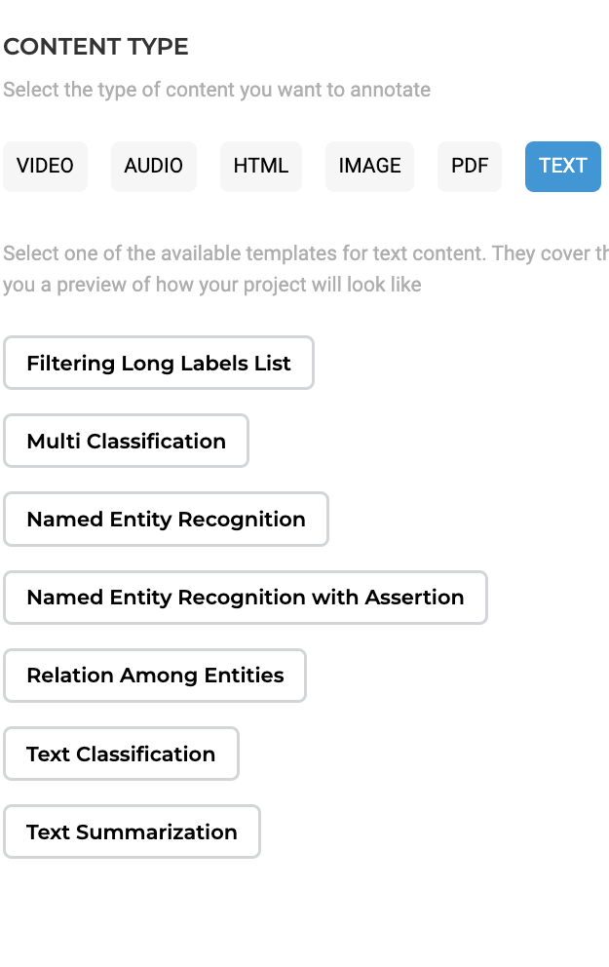
Exercise: Project Creation/Classification
Select Text Classification and click Next.
In Step 2 and 3 leave the default settings and click Next.

Slide 32
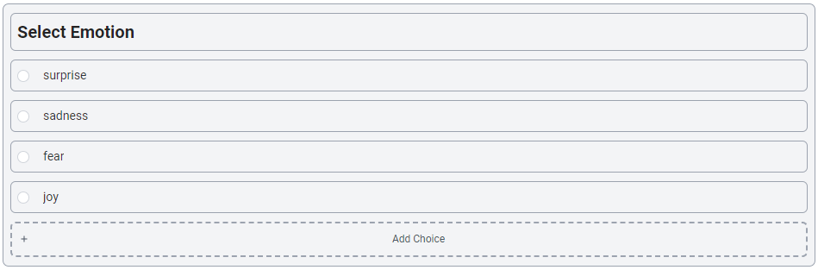
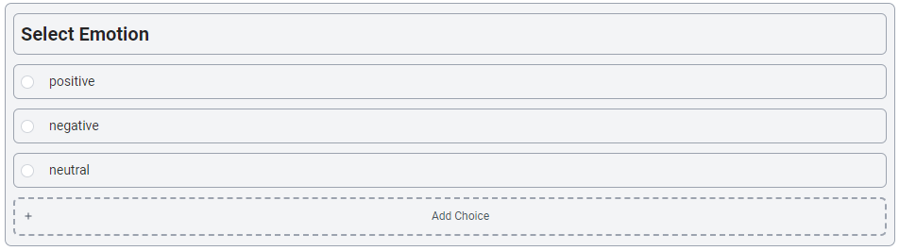
Exercise: Project Creation/Classification-cont
In Step 4 "Customize Labels“, by default, few choices are already populated for you.
Add yours then remove existing ones then click the Save Config button.
We will be classifying tweets in this project so the choices we add are “positive”, “negative” and “neutral”
This takes us to the Import page where tasks will be imported into the project.

Slide 33
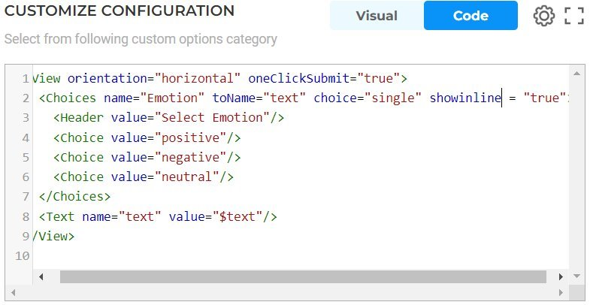
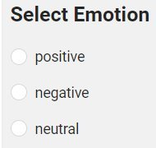

Exercise: Project Creation/Classification-cont
Customize how you view your choices
By default, the choices are listed vertically. If you prefer to list them horizontally, switch to Code view and add “showInLine” tag set to True

Slide 34
Task Import and Assignment
The screenshot below shows the import page:

Slide 35
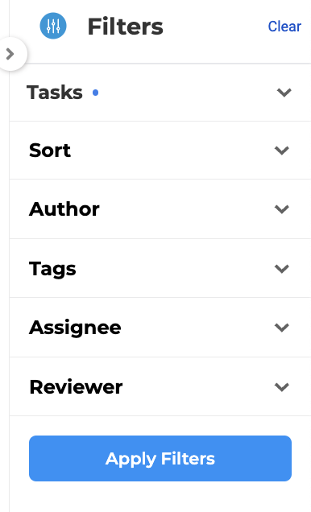
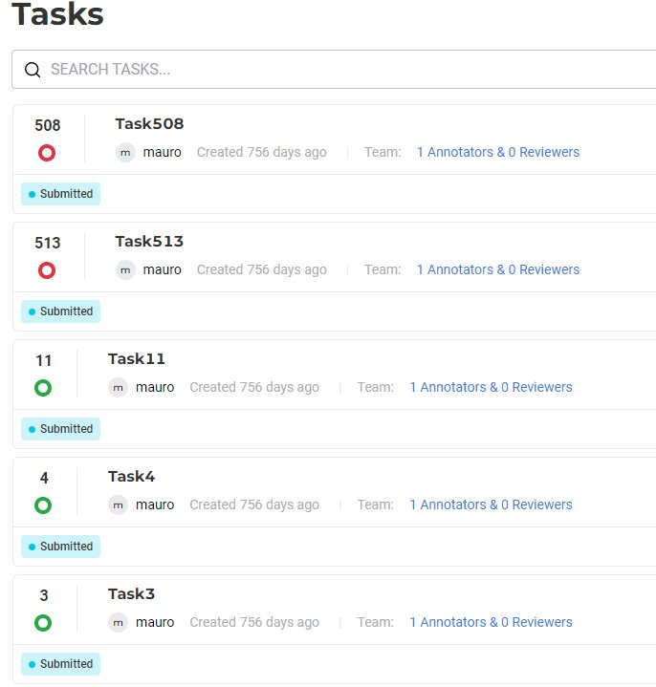
Task Import and Assignment
Once you import the tasks, choose to Explore tasks; this takes you to the Tasks page. As a project owner you will start assigning tasks to Annotators.
select one or more tasks, click on Assign drop down and select the name of the user to assign selected tasks. Repeat this step to continue assigning tasks.

Slide 36
Outline
1. Introduction to Text Annotation
2. Manual Annotation
3. Annotation Guidelines
4. Project Setup and Management
5. Preannotations
6. Conclusions and further resources

Slide 37
Contents
1.
Stakeholders and Roles
2.
Structure and Content of AG
3.
Best Practices
4.
Annotation Errors
5.
Project Analysis

Slide 38
Stakeholders and Roles

Slide 39
Stakeholders and Roles
Annotator Lead
oversees the entire project - > guidelines align with the project's objectives
keeps track of changes with a Change Log
manager role in projects
Annotators
usually medical professionals (MDs, nurses etc.)
assess/curate data/annotate
annotator/reviewer role in projects

Slide 40
Stakeholders and Roles
Data Scientist
technical stakeholders who will use the annotated data for training
provide requirements for annotation granularity and specificity
Quality Assurance (Reviewers)
ensure the quality and consistency of the annotations and AGs
usually, an experienced annotator from the team is assigned as reviewer

Slide 41
Structure and Content of AG

Slide 42
Contents
Cover Page
Table of Contents
Introduction
Taxonomy
NER Labels
Assertion Labels
Relations
Text Classification
Appendix
Changelog

Slide 43
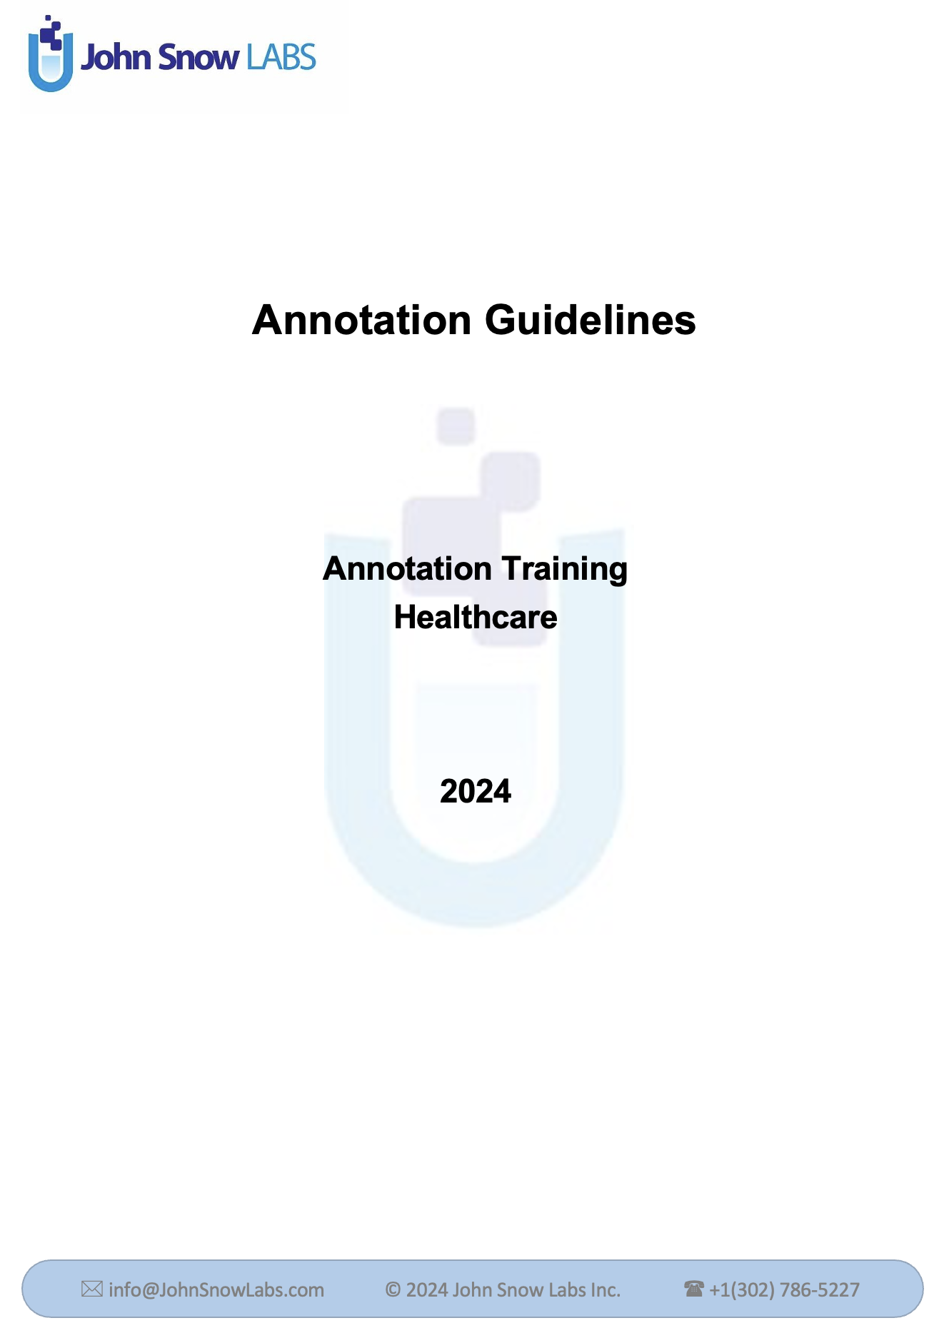
Contents
Cover Page
Table of Contents
Introduction
Taxonomy
NER Labels
Assertion Labels
Relations
Text Classification
Appendix
Changelog

Slide 44
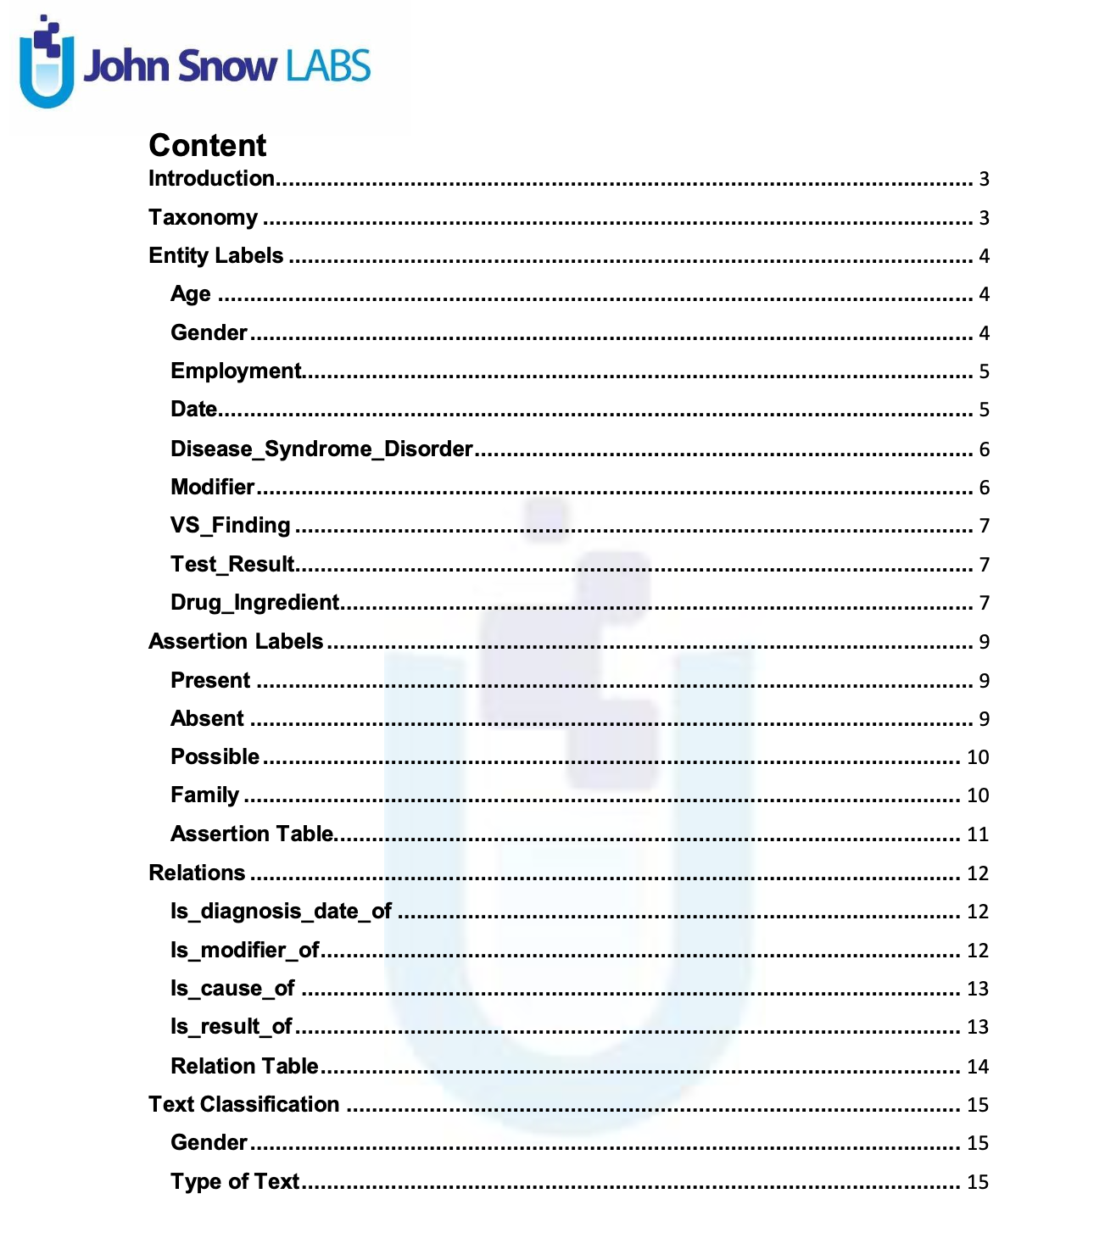
Contents
Cover Page
Table of Contents
Introduction
Taxonomy
NER Labels
Assertion Labels
Relations
Text Classification
Appendix
Changelog

Slide 45
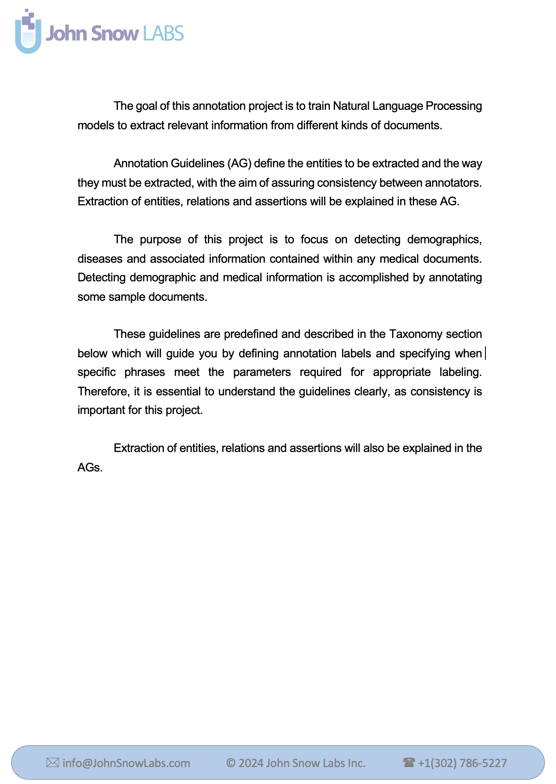
Contents
Cover Page
Table of Contents
Introduction
Taxonomy
NER Labels
Assertion Labels
Relations
Text Classification
Appendix
Changelog

Slide 46
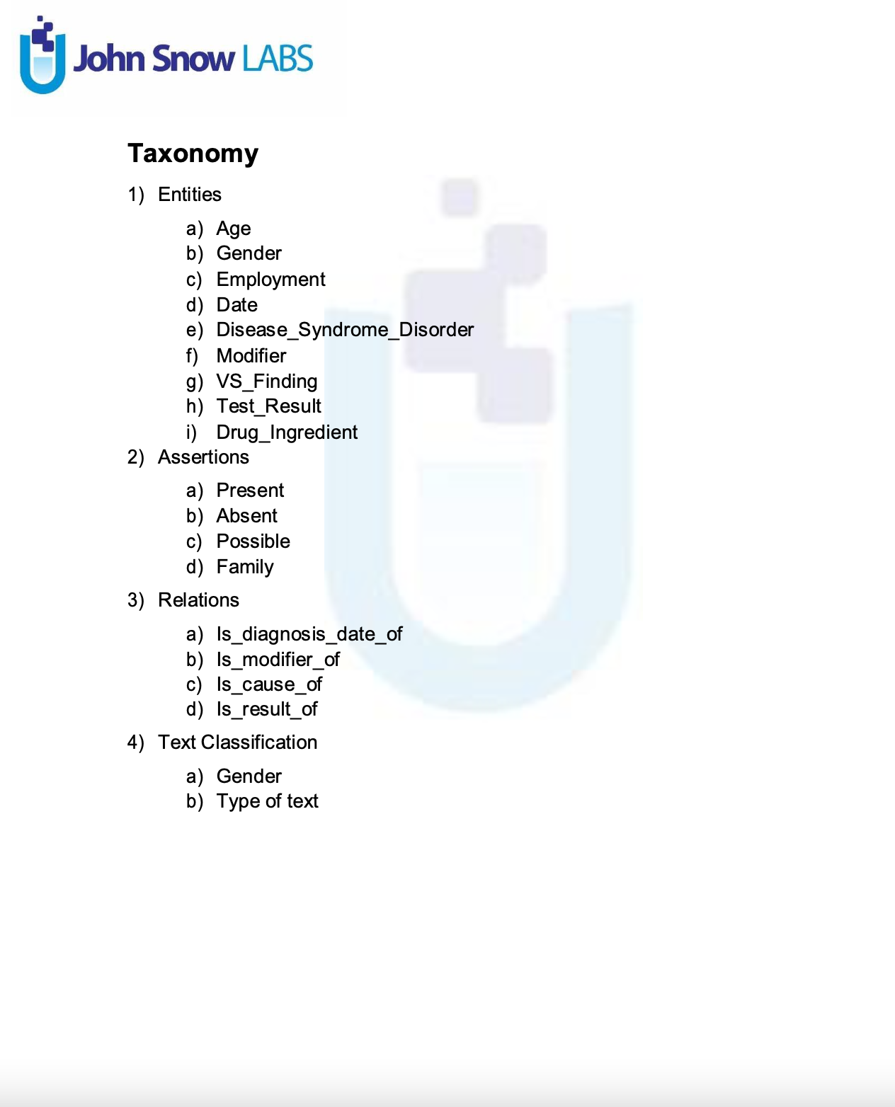
Contents
Cover Page
Table of Contents
Introduction
Taxonomy
NER Labels
Assertion Labels
Relations
Text Classification
Appendix
Changelog

Slide 47
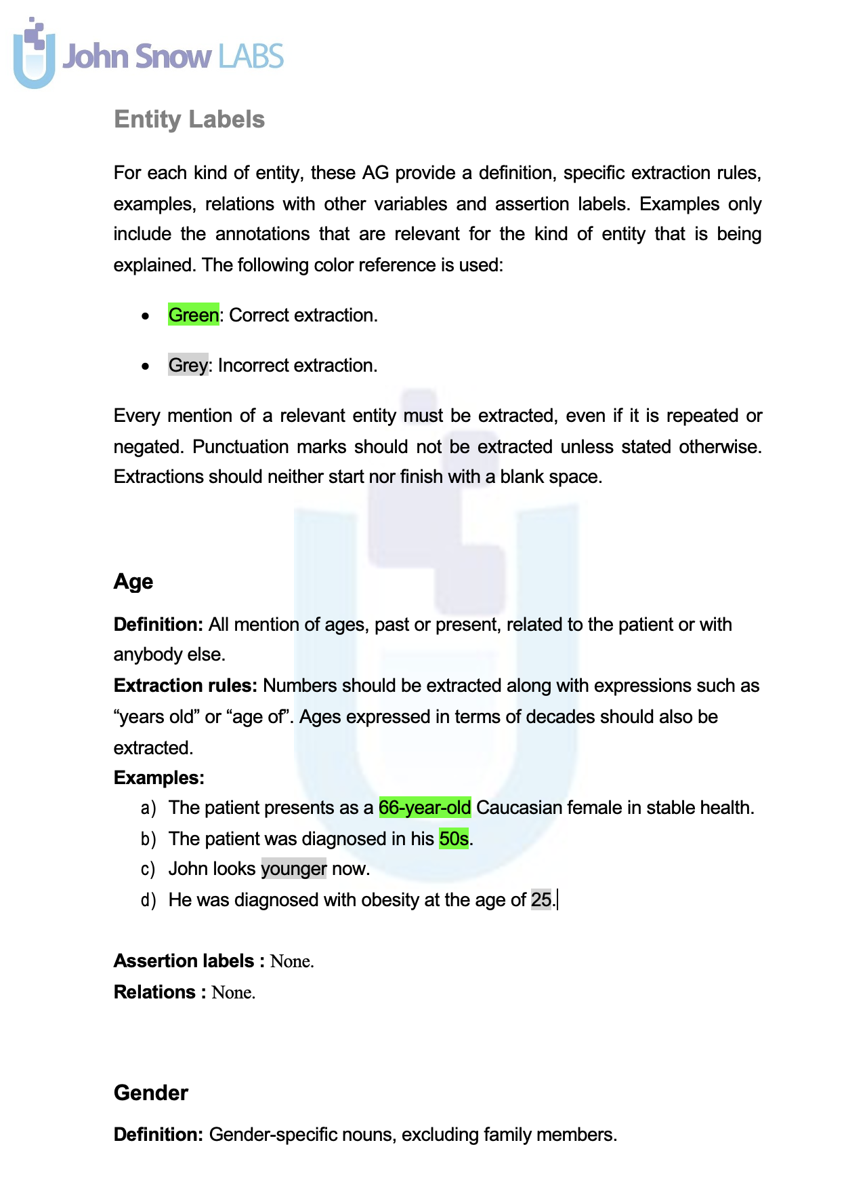
Contents
Cover Page
Table of Contents
Introduction
Taxonomy
NER Labels
Assertion Labels
Relations
Text Classification
Appendix
Changelog

Slide 48
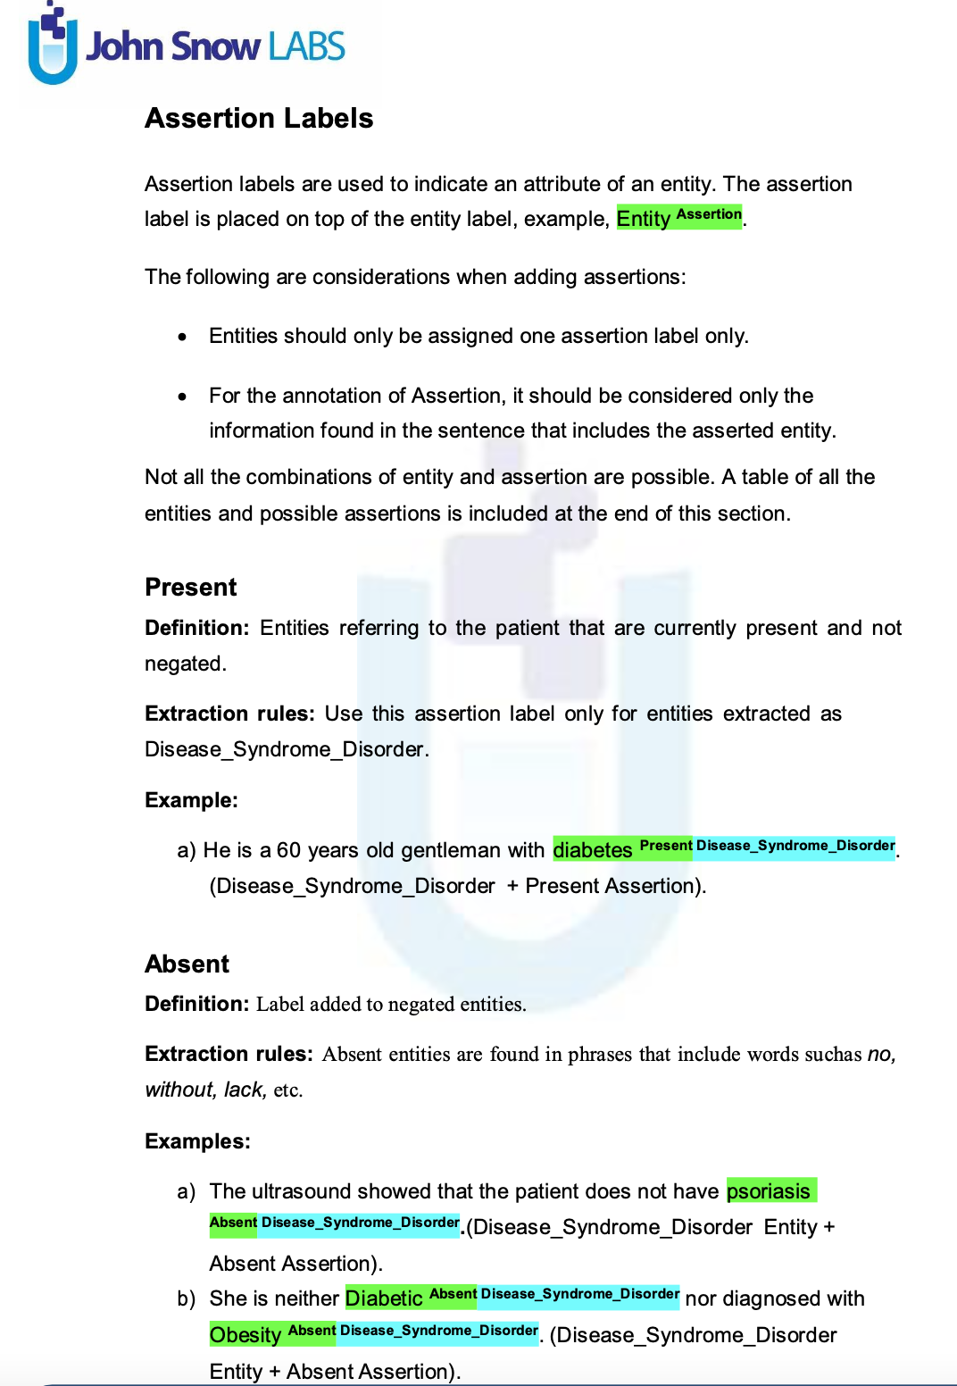
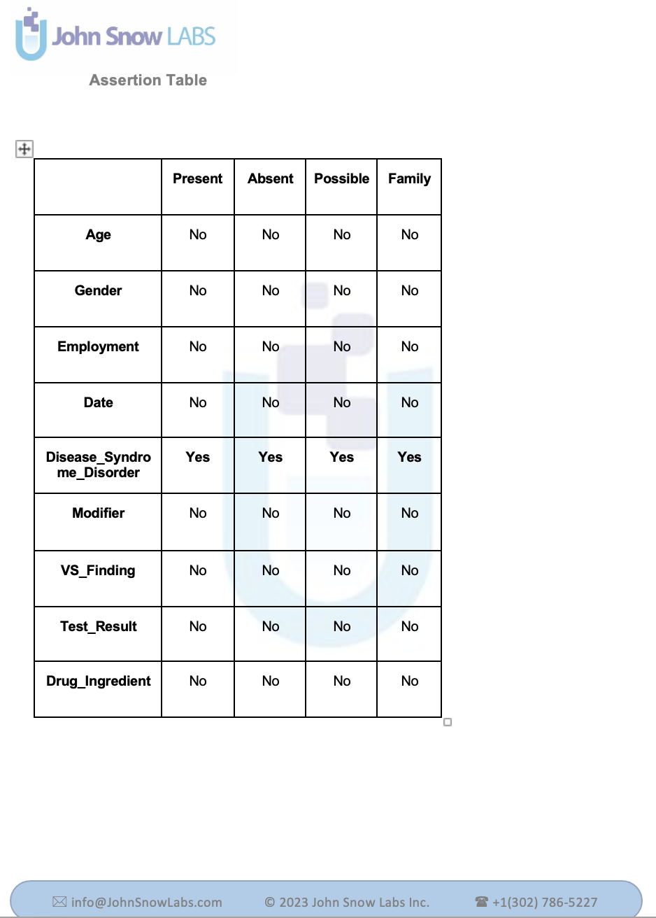
Contents
Cover Page
Table of Contents
Introduction
Taxonomy
NER Labels
Assertion Labels
Relations
Text Classification
Appendix
Changelog

Slide 49
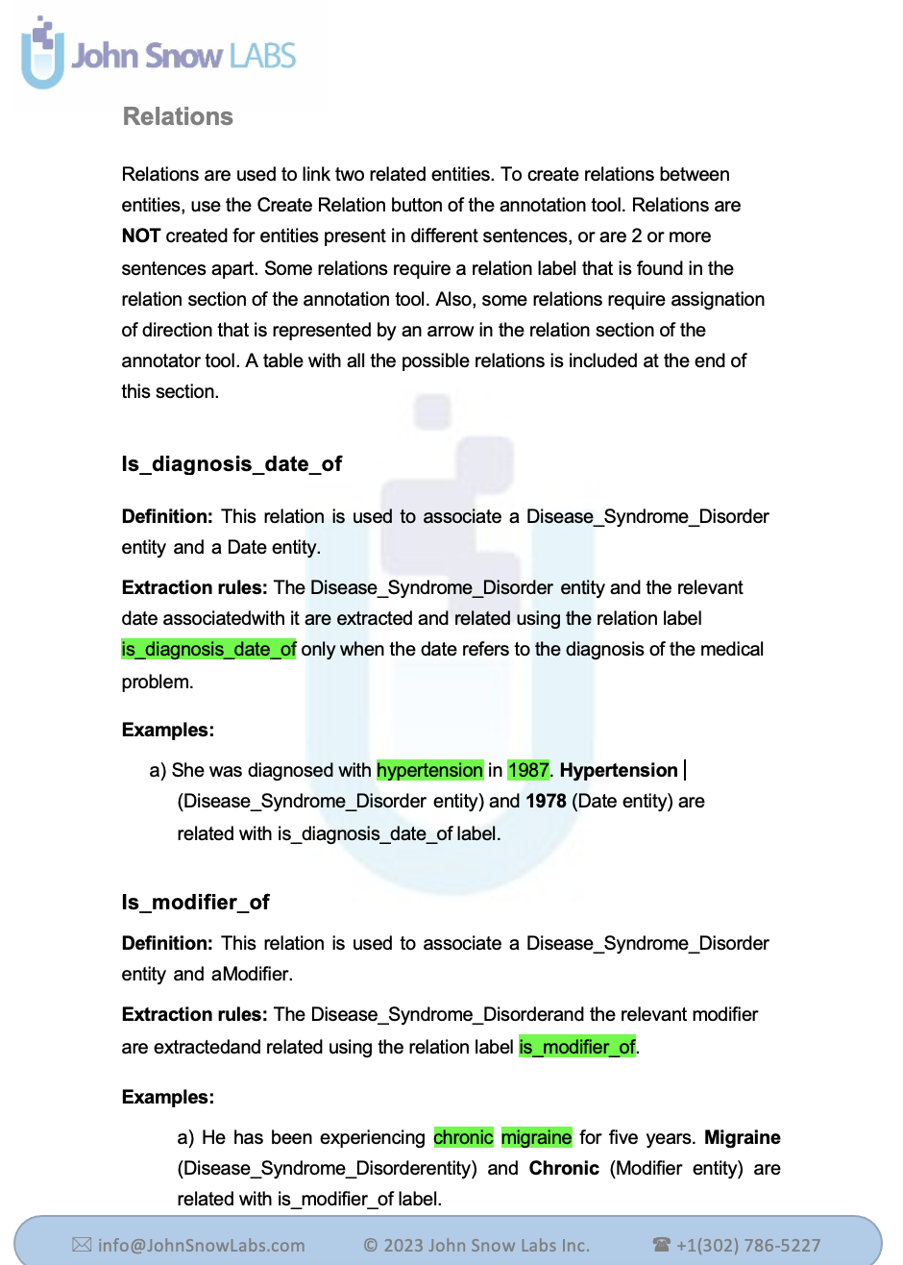
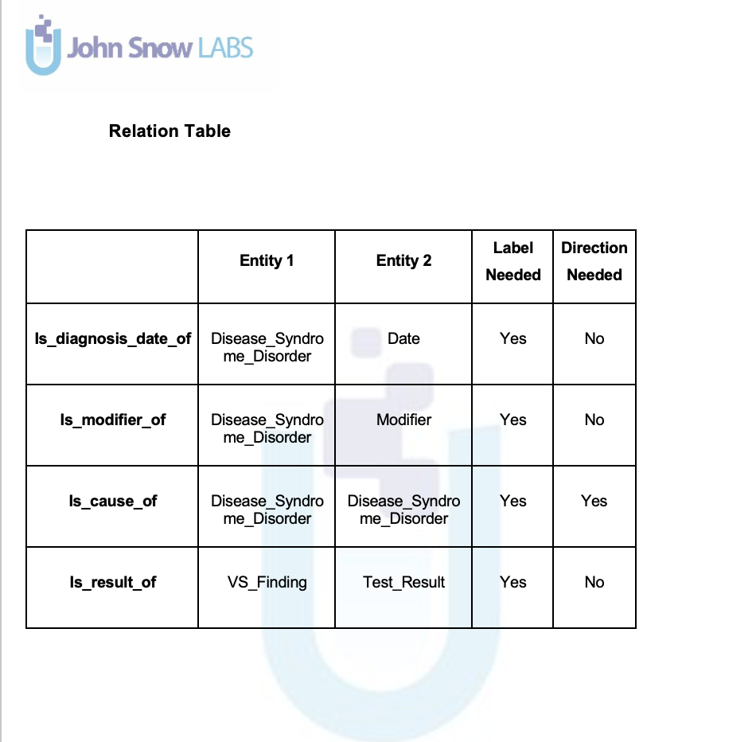
Contents
Cover Page
Table of Contents
Introduction
Taxonomy
NER Labels
Assertion Labels
Relations
Text Classification
Appendix
Changelog

Slide 50
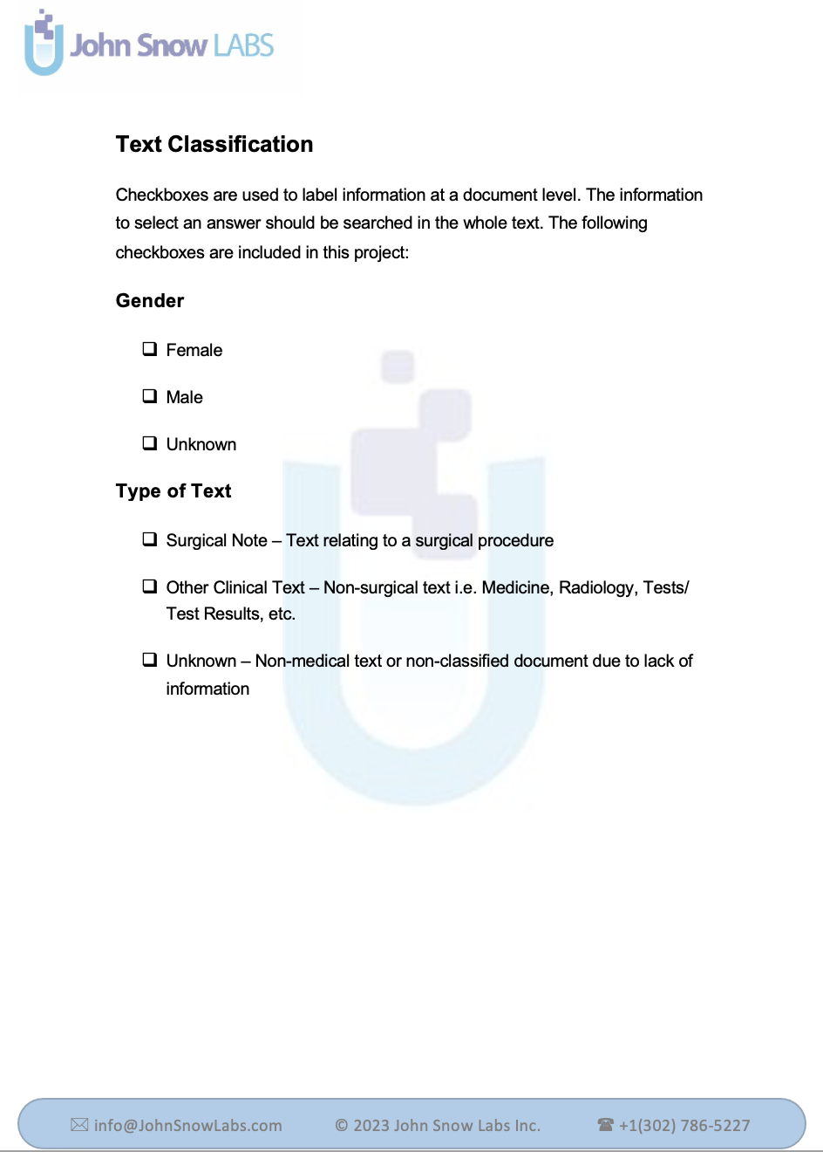
Contents
Cover Page
Table of Contents
Introduction
Taxonomy
NER Labels
Assertion Labels
Relations
Text Classification
Appendix
Changelog

Slide 51
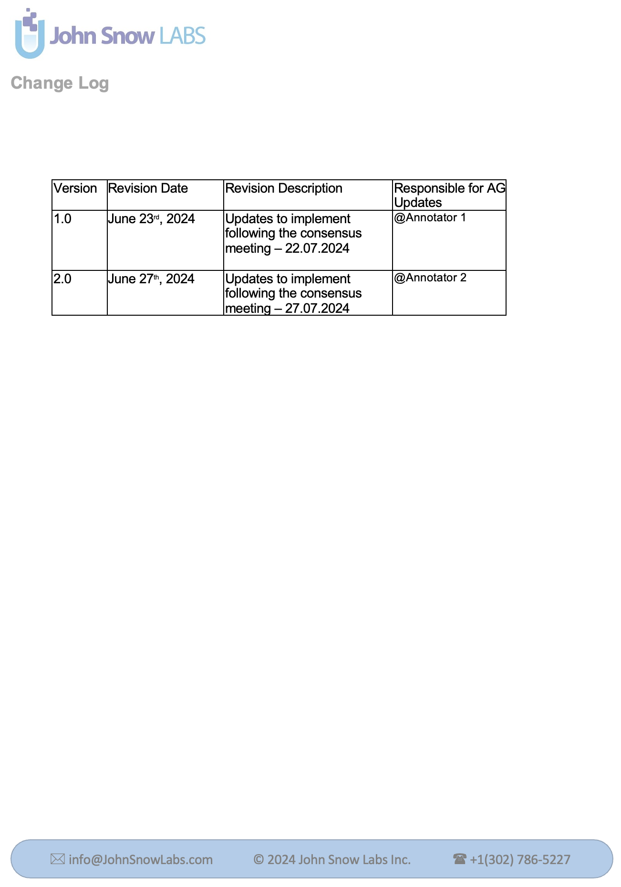
Contents
Cover Page
Table of Contents
Introduction
Taxonomy
NER Labels
Assertion Labels
Relations
Text Classification
Appendix
Changelog

Slide 52
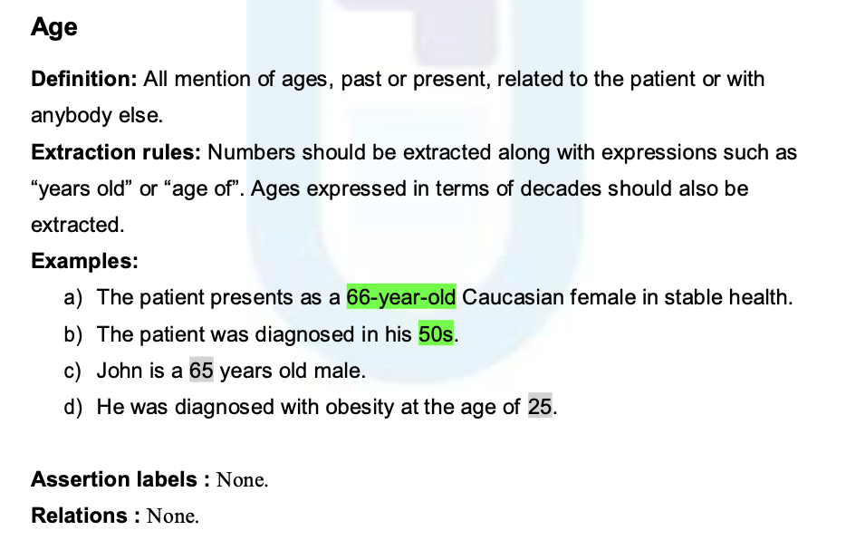
Examples #1

Slide 53
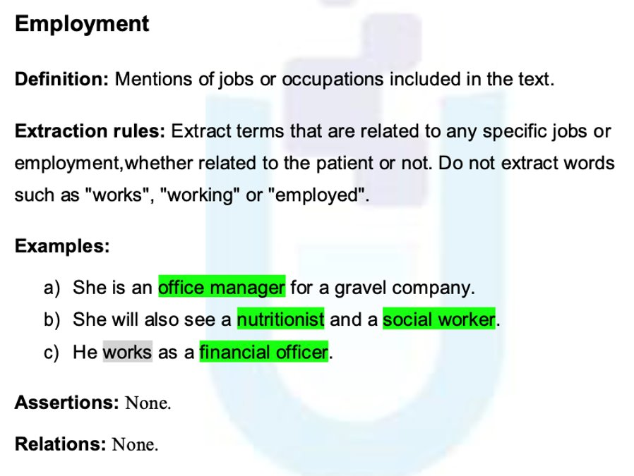
Examples #2

Slide 54
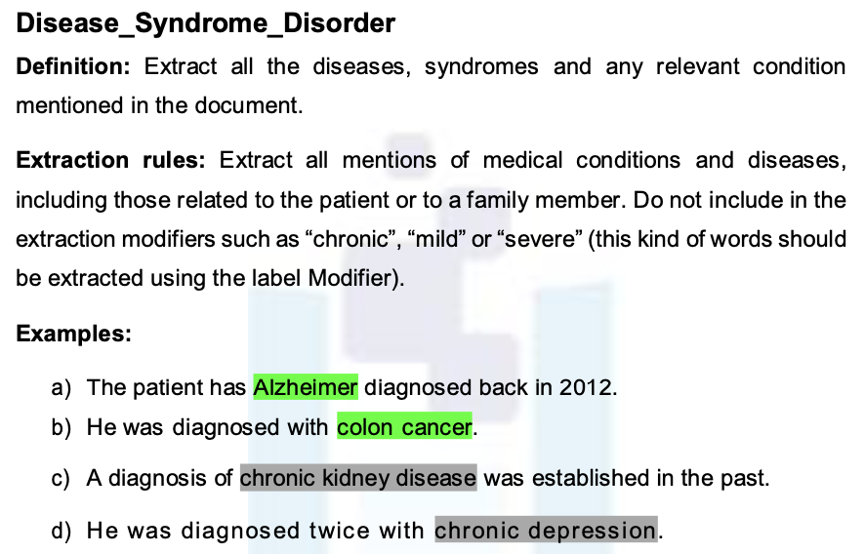
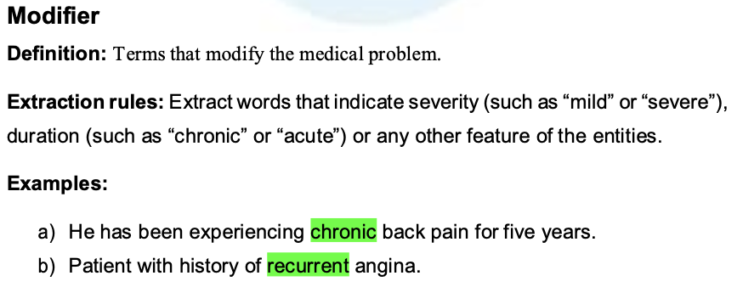
Examples #3

Slide 55
Best Practices

Slide 56
Best Practices - Annotation Rules
Centralized
one document should include all the rules
(the AGs)
Consistent
contradiction should be avoided
Specific
ambiguity should be avoided
Cross-check Annotations
Use multiple annotators for the same data
(“seed corpus”)
Clear Objectives
objectives will shape your annotation guidelines
Explicit
i.e written (even if in detail!)

Slide 57
Best Practices - AG Development
Define goals clearly
Communication is key
Iterative process
What information is needed from texts?
Define communication channels (Slack, Teams etc.)
Test your AGs
e.g.: “identifying all gender-related words (NER)”
vs.
“classifying the document based on gender” (Text Classification +/- NER)
Keep track of decisions made (Change Log)
Seed Corpus annotations (pilot)
Encourage annotators to avoid private messaging
data scientists/NLP engineers

Slide 58
Best Practices - NER
vs
vs
Define the level of granularity of your taxonomy
e.g.: Clinical_Problem label vs. Modifier + Symptom
Each label should have clear boundaries (avoid overlapping)
e.g.: “Treatment will involve the drug Tarceva”
(Cancer_Treatment vs Drug)

Slide 59
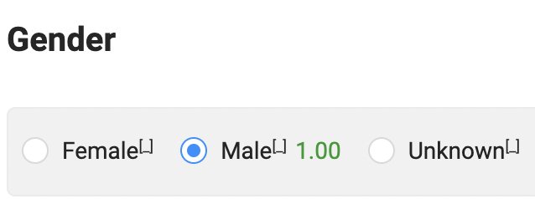
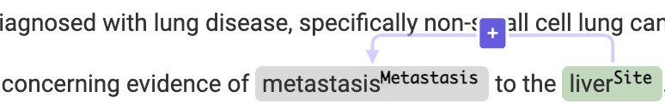
Best Practices - NER
vs
Extractions should not include more than 2-3 words!
Consider merging/dropping/splitting entities
e.g.: “There is metastasis in the lung” (Metastasis > Metastasis + Site)
Combine NER with other NLP features
assertion labels
relations
text classification

Slide 60
Best Practices - Assertion
Keep Assertion Taxonomy simple!
vs
Assign a default assertion status
e.g.: “The patient has cancer”. (Disease + Present assertion label by Default)
Define each assertion label
How to decide between multiple possible assertion labels
e.g.: “No family history of cancer”. (Disease + Absent/Family?)
Create your own assertion labels
e.g.: "medical history reveals an allergy to penicillin” (Drug NER label + Allergen assertion label)

Slide 61
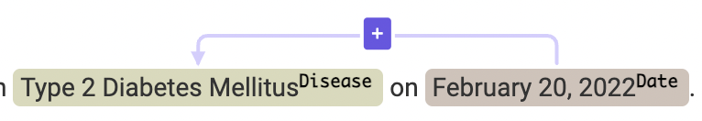
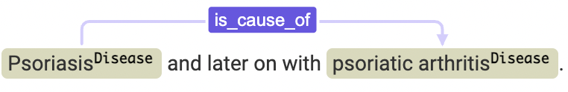
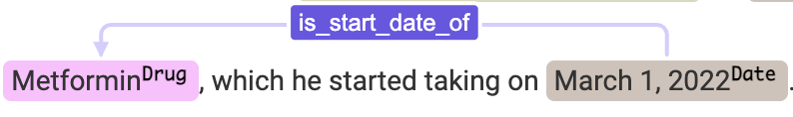
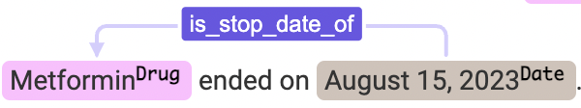
Best Practices - Relations
Define entities that can be related!
Add Relation Labels Names only when there are different ways of relating two entities
Disease & Date (1 relation): no need to add a Label is_date_of_diagnosis
Drug & Date (3 relations): label needed (is_start_date_of, is_stop_date_of, is_generic_date_of)
Add direction only if necessary
is_cause_of (Disease & Disease) needs direction to differentiate cause and consequence
Define the distance between entities to use relation label

Slide 62
Frequent Annotation Errors

Slide 63
Cause of Error
1. Accidental Human Error
Example: “female" extracted as Age
2. Wrong Extraction
Example: “young" extracted as Age (if AG specify that only numeric values should be extracted).
3. Normal Disagreement
Example: different granularity to extract “late 40s“ as Age.

Slide 64
Kinds of NER Errors
1. Missing Extraction
“The patient is 30 years old” [O]
2. Wrong Label
“The patient is 30 years old” [Gender]
3. Wrong Granularity
“The patient is 30 years old” [Age]
4. Wrong Extraction
“The patient is young” [Age] (redundant if AG specify “only numeric values”)

Slide 65


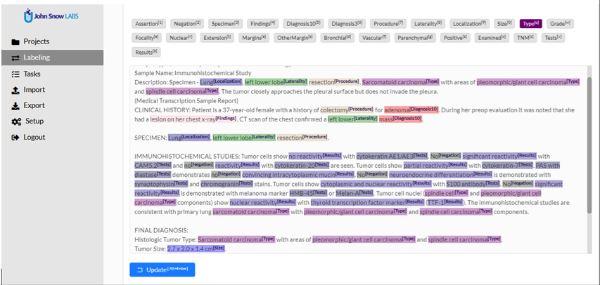
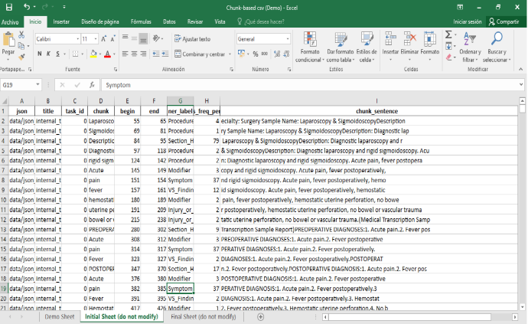
Data Review
Manual Reviews
CSV Reviews

Slide 66
Project Analytics

Slide 67
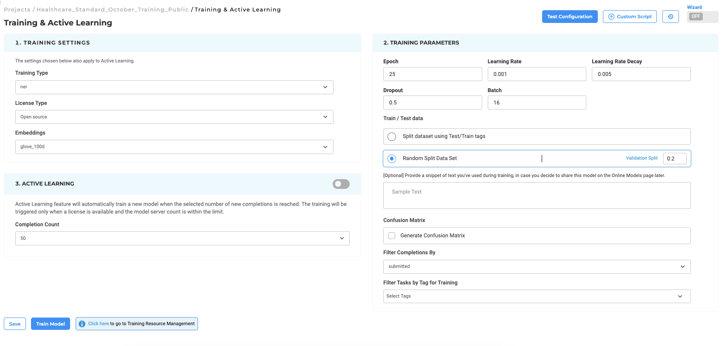
Model Training
Notes:
Once your team of annotators have put up enough examples with the model to work from you can go ahead and retain your model on your data, which will be a minimum of 50 examples for each entity, which you can see in the analytics.
To start your training you can go to the training page.
You’ll have multiple options here for the training type, since you can’t pick all three models at the same time. So Your classification model is separate from your assertion status model, etc.
All the entities that you have in your taxonomy in the included automatically. Then, you need to select your license type, this affects the embeddings that are available.
Embeddings are very important because this is the way that words are translated into a high level numerical space— their meaning is related to numbers.., the best one currently for healthcare is embeddings_clinical.
Then you have the option to train from scratch, that is, you don’t have any base models to improve.
The second option is to loose transfer learning. You’ll have to pick one available model to start from. The entities in this model should have some sort of coverage with respect to your taxonomy.
It makes sense to use transfer learning when you already have a model that you’ve used for pre-annotation.
Include base model labels when your base model contains more model labels than is currently used in your project.
ON the right side you have the training parameters. For instance, your epochs on the right hand side will change the weight of the model change as a result of the new data. Each epoch is an adjustment of all the weights of your model according to your input data.
The learning rate determines the size of the steps taken during the optimization process when updating the model's weights.
A suitable learning rate helps the model converge to a good solution without oscillating or diverging. Too high a learning rate can lead to instability, while too low a rate can result in slow convergence.
Learning rate decay refers to the gradual reduction of the learning rate over time during training.
It allows the model to make larger updates in the initial phases of training (to quickly find a good region in the loss landscape) and smaller updates as training progresses (to fine-tune the model). Step decay is a very common method.
Dropout is a regularization technique that randomly sets a fraction of the neurons to zero during training to prevent overfitting.
By randomly dropping units, dropout helps the model generalize better to unseen data. The dropout rate (the probability of dropping a neuron) typically ranges from 0.2 to 0.5, depending on the complexity of the model and the amount of training data.
Batch size refers to the number of training examples used in one iteration of model training.
A smaller batch size can lead to a more accurate estimate of the gradient but may take longer to train due to more frequent weight updates. Conversely, a larger batch size can speed up training but may lead to poorer generalization. Common batch sizes range from 16 to 256, depending on the available computational resources and the dataset size.
We recommend that you use the defaults, which fit the majority of the situations.
For training a model based on 100 tasks, you can use a pool of tasks, you can use some of them to train the model and some to test the data.
You can choose to share a snippet of test you used during training, in case you would like to publish your model later.
You can also generate the confusion matrix which will give you a good idea of the overlapping entities which will give you a good idea which entities may require better annotation guidelines.
You can also filter based on additional tags which allows you to only train a certain model on certain data.
Of course, active learning will automatically be triggered on your model after a set number of completion
s.

Slide 68
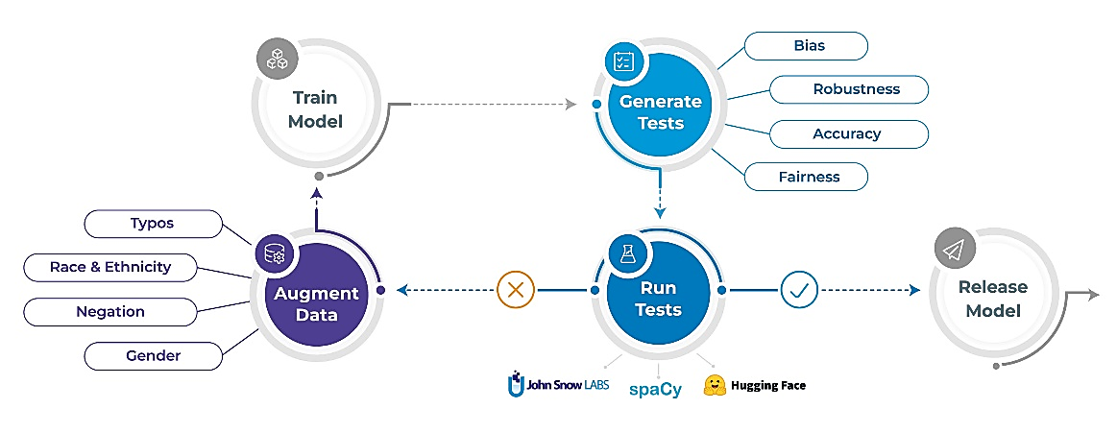
Model Testing Flow
Pick a model to test. Generative tests. Run tests. Improve system until the tests pass.
Automated test generation & execution is based on the LangTest library.

Slide 69

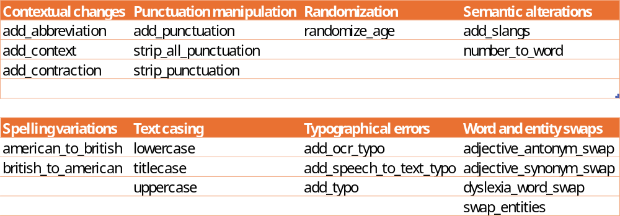
Robustness Tests
Are your model's predictions stable under small perturbations of the input?
Notes:
Firstly, we know that every good model is robust, so we add the robustness tests as a matter of course. These tests are designed to account for issues in the text such as a typo, a lack of punctuation or other concerns.
Adding these tests is simply good model hygiene, and is useful regardless of the data source. For the testing, we will generate test cases what we know to have these

Slide 70
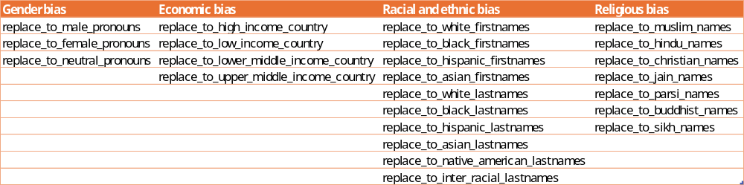
Bias Tests
Does your model change its answer if a person’s name is changed to be female, Muslim, or Hispanic?

Slide 71

Fairness Tests
Is your model accurate for men and for women?
Notes:
Fairness testing is a more holistic test that encompasses the entire pipeline to ensure that the outcomes are as expected.

Slide 72

Representation Tests
Are there enough cases of each gender, ethnicity, religion, and country to even calculate fairness?
Notes:
Representation tests ensure that there is enough cases so that all minorities have fair representation in the data.

Slide 73


More Test Types
Accuracy
Speed
Notes:
Additional test types that are available in the product already include accuracy and performance. More test types are being added continuously as they become available from langtest.

Slide 74

Create Tests with the Test Page Wizard
Notes:
To create your test, once you've chosen the model that has been loaded into the project, you can use the test suite wizard to get started. You'll be asked to choose your test suite, the model you'll be testing it on, and which types of tasks to consider when running the tests. After this, just click safe, and then generate test cases.

Slide 75

Use Generative AI to Auto-Generate Test Cases
Notes:
After the test suite has been created, we can navigate to the test page for the product, by default the model chosen to pre-annotate will be available from the main page, but you can also use a wizard to test a different model on the project data as well.
Then, we will create the test suite that Generative uses to evaluate the suite. This will take some time, depending on the amount of tests you're trying to run. The test suite that I have chosen goes on to generate a few thousand unique test cases, which does take some minutes depending on the resources available on the server.
After you've created the test cases, you are able to review them, or simply continue to start testing.
Once you've run your test you can navigate over the test cases tab and

Slide 76
Run Tests and Visually Review Results
Notes:
After the test suite has been created, we can navigate to the test page for the product, and use the wizard to confirm that we are testing the correct model on our data.
Then, we will create the test suite that Pacific AI uses to evaluate the suite. This will take some time, depending on the amount of tests you're trying to run.

Slide 77

Augmented Data
Why Use Augmented Data?
HIPPA compliant
Designed to fill holes in original dataset
Generate additional possible cases the model can use to impove itself

Slide 78

Data Augmentation: Don’t Just Test It, Fix It!
Expand the model’s training dataset by generating templatic variations of existing data (e.g., rotations, noise addition, translations) to help the model learn more diverse patterns.
Notes:
Creating augmented tasks is possible by reviewing the existing submitted data that has been reviewed in the tasks page to create a template, uses the labels that are already applied in order to make a new task.
this is different from synthetic data because it allows us to have more control over the types of tasks that are being imported without having to design a prompt, and it decreases the amount of drift that can come from something like an LLM.

Slide 79

Synthetic Data – Use Open AI
Create net-new templates and data using our chatgpt integration.
Notes:
Synthetic data
THE Quality of your synthetic data is not pre-determined by your previous tasks, but instead is determined by the quality of your prompt engineering.
To use synthetic tasks you will have input your secret key from an existing openai account.

Slide 80
What are Audit Logs
A record of system activities to enable reconstruction and examination of sequences of events
Captured Events Include:
  User logins/logouts
  Data access/modification
  System and application errors
  Configuration changes

Slide 81
Purpose of
Audit Logs
Security Monitoring
  Detect suspicious or unauthorized activities
Accountability
  Identify who did what and when
Incident Investigation
  Reconstruct events after a breach or error
System Optimization & Debugging
  Track performance issues and failures

Slide 82
Importance of
Audit Logs in Healthcare
Protecting Electronic Protected Health Information (ePHI)
Preventing unauthorized access or data misuse
Maintaining audit trails for all data operations
Helping detect policy violations or breaches
Supporting investigation & mitigation during incidents

Slide 83
HIPAA
Audit Logs Requirements
Who accessed the data?
What data was accessed or changed?
When and where the access occurred?
Whether access was successful or failed?
Retain logs for at least 6 years

Slide 84
Audit Dashboards in Generative AI Lab

Slide 85

Project Activity
Visual Representation of user activity on a project across a configurable time range
Color intensity indicates volume or frequency of actions
Identify peak activity days for any project
Detect unusual spikes in project usage
Also helps in capacity planning

Slide 86

New Projects Over Time
Shows who created what and when
Supports change control tracking in a regulated environment
Track the number of new projects created over a selected time range
Helps identify onboarding success for new users/teams

Slide 87

Deleted Projects Audit
Displays a timeline of project deletions
Ensures deletion events are tracked and attributable
Enables investigation of malicious or accidental deletions
Supports enforcement of data retention policies

Slide 88

Exported Projects Tracking
Shows the projects exported by users within a time range
Monitors data movement and external sharing
Enables tracking of collaborative or handoff workflows
Tracks all export operations for auditing and investigation
Detects potential data exfiltration risks

Slide 89

User Activity on a Project
Detailed timeline of user actions within a selected project
Tracks all activities such as:
  Submission/Deletion of Annotations
  Import/Export of Patient charts
  Adding/Removing Assignees/Reviewers
  And so on...
Provides fine-grained visibility into who did what and when

Slide 90
User Activity on a Project
Helps monitor collaboration, progress and workflow patterns
Detects unusual or potentially harmful activity within a project
Ensures full traceability for all actions taken within a project
Essential for incident investigation and access accountability

Slide 91




Additional Dashboards

Slide 92
Additional Dashboards

Slide 93
Additional Dashboards

Slide 94
Additional Dashboards

Slide 95
Additional Dashboards

Slide 96


Enabling Audit Trails
Audit Trail logging can be enabled with just a simple installer modification
Add the following flags to your install script:
No additional configuration required, logs will start capturing immediately after deployment

Slide 97
Quick Install
AWS Marketplace
Azure Marketplace
On-Premise
Support
Slack
Email

Slide 98

Learning Resources
Docs
https://www.johnsnowlabs.com/generative-ai-lab/
https://nlp.johnsnowlabs.com/docs/en/alab/quickstart
Tutorials
https://nlp.johnsnowlabs.com/docs/en/alab/step_by_step_tutorials
Blog
https://www.johnsnowlabs.com/nlp-lab-blog/

Slide 99
Thank you for joining!
dia@johnsnowlabs.com

